Slide 1


GDP fluctuation by Covid Pandemic
Elnaz Talebi

Slide 2



Agenda
What is GDP?
Why GDP?
Visualization Tools
Data Preparation
Data Visualization
Reference

Slide 3

What is GDP?
GDP Growth Rate
compares the year-over-year (or quarterly) change in a country’s economic output to measure how fast an economy is growing.
GDP Purchasing Power Parity (PPP)
Measures of the country’s GDP in “international dollars” using a method that adjusts for differences in local prices and costs of living to make cross-country comparisons of real output, real income, and living standards.
Gross Domestic Products (GDP)
Gross domestic product (GDP) is the total monetary or market value of all the finished goods and services produced within a country’s borders in a specific time period
Nominal GDP
An assessment of economic production in an economy that includes current prices in its calculation
GDP Per Capita
A measurement of the GDP per person in a country’s population.
This GDP project visualization is based on real GDP.

Slide 4
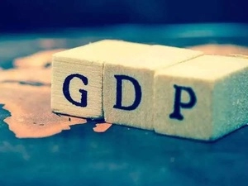
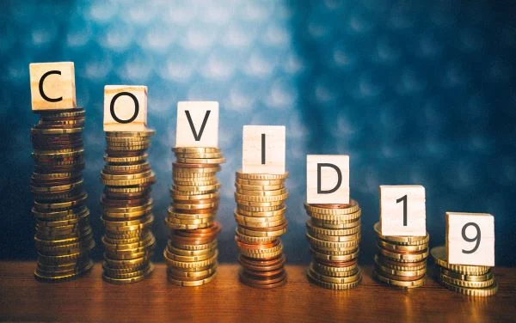
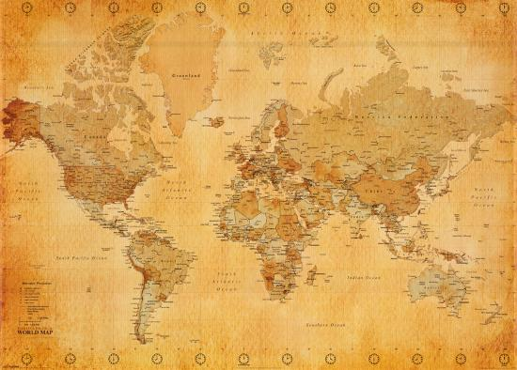

Why GDP?
GDP is important because it gives information about the size of the economy and how an economy is performing. The growth rate of real GDP is often used as an indicator of the general health of the economy. In broad terms, an increase in real GDP is interpreted as a sign that the economy is doing well.
The toll the COVID-19 pandemic has exacted on the global economy has been significant, with the International Monetary Fund (IMF) estimating that median global GDP dropped by 3.9% from 2019 to 2020, making it the worst economic downturn.
GDP can be calculated in three ways, using expenditures, production, or incomes. It can be adjusted for inflation and population to provide deeper insights.

Slide 5

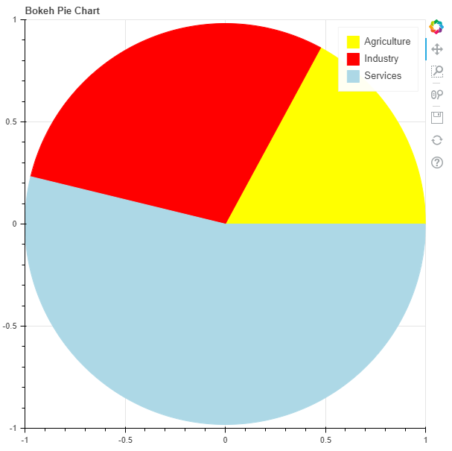

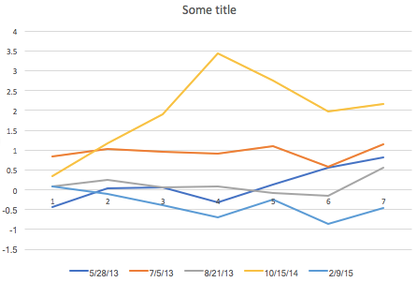


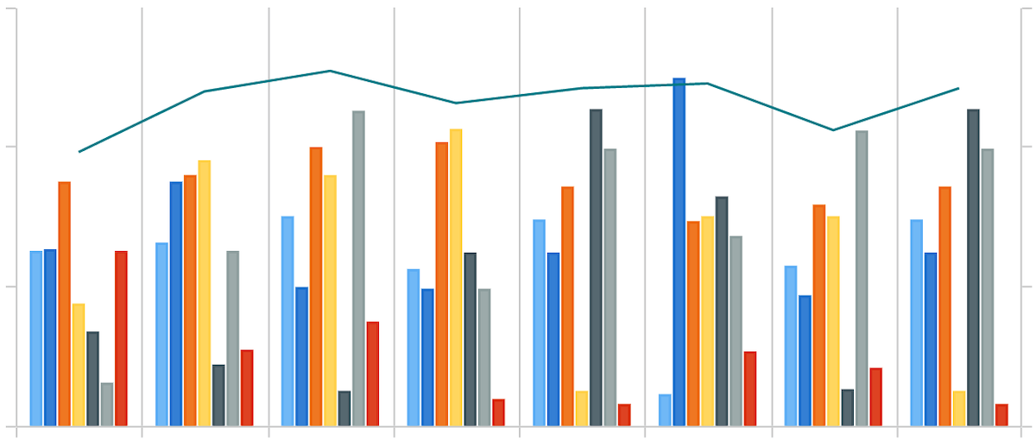
Visualization Tools
The GDP project is the combination of 4 different data set that is downloaded from Kaggle website and after cleaning 90 countries with their total record were used for visualization.
Charts :
Bar
Line
Pie
Area
Libraries :
Pandas
Numpy
Seaborn
Pandas.bokeh
Matplotlib

Slide 6
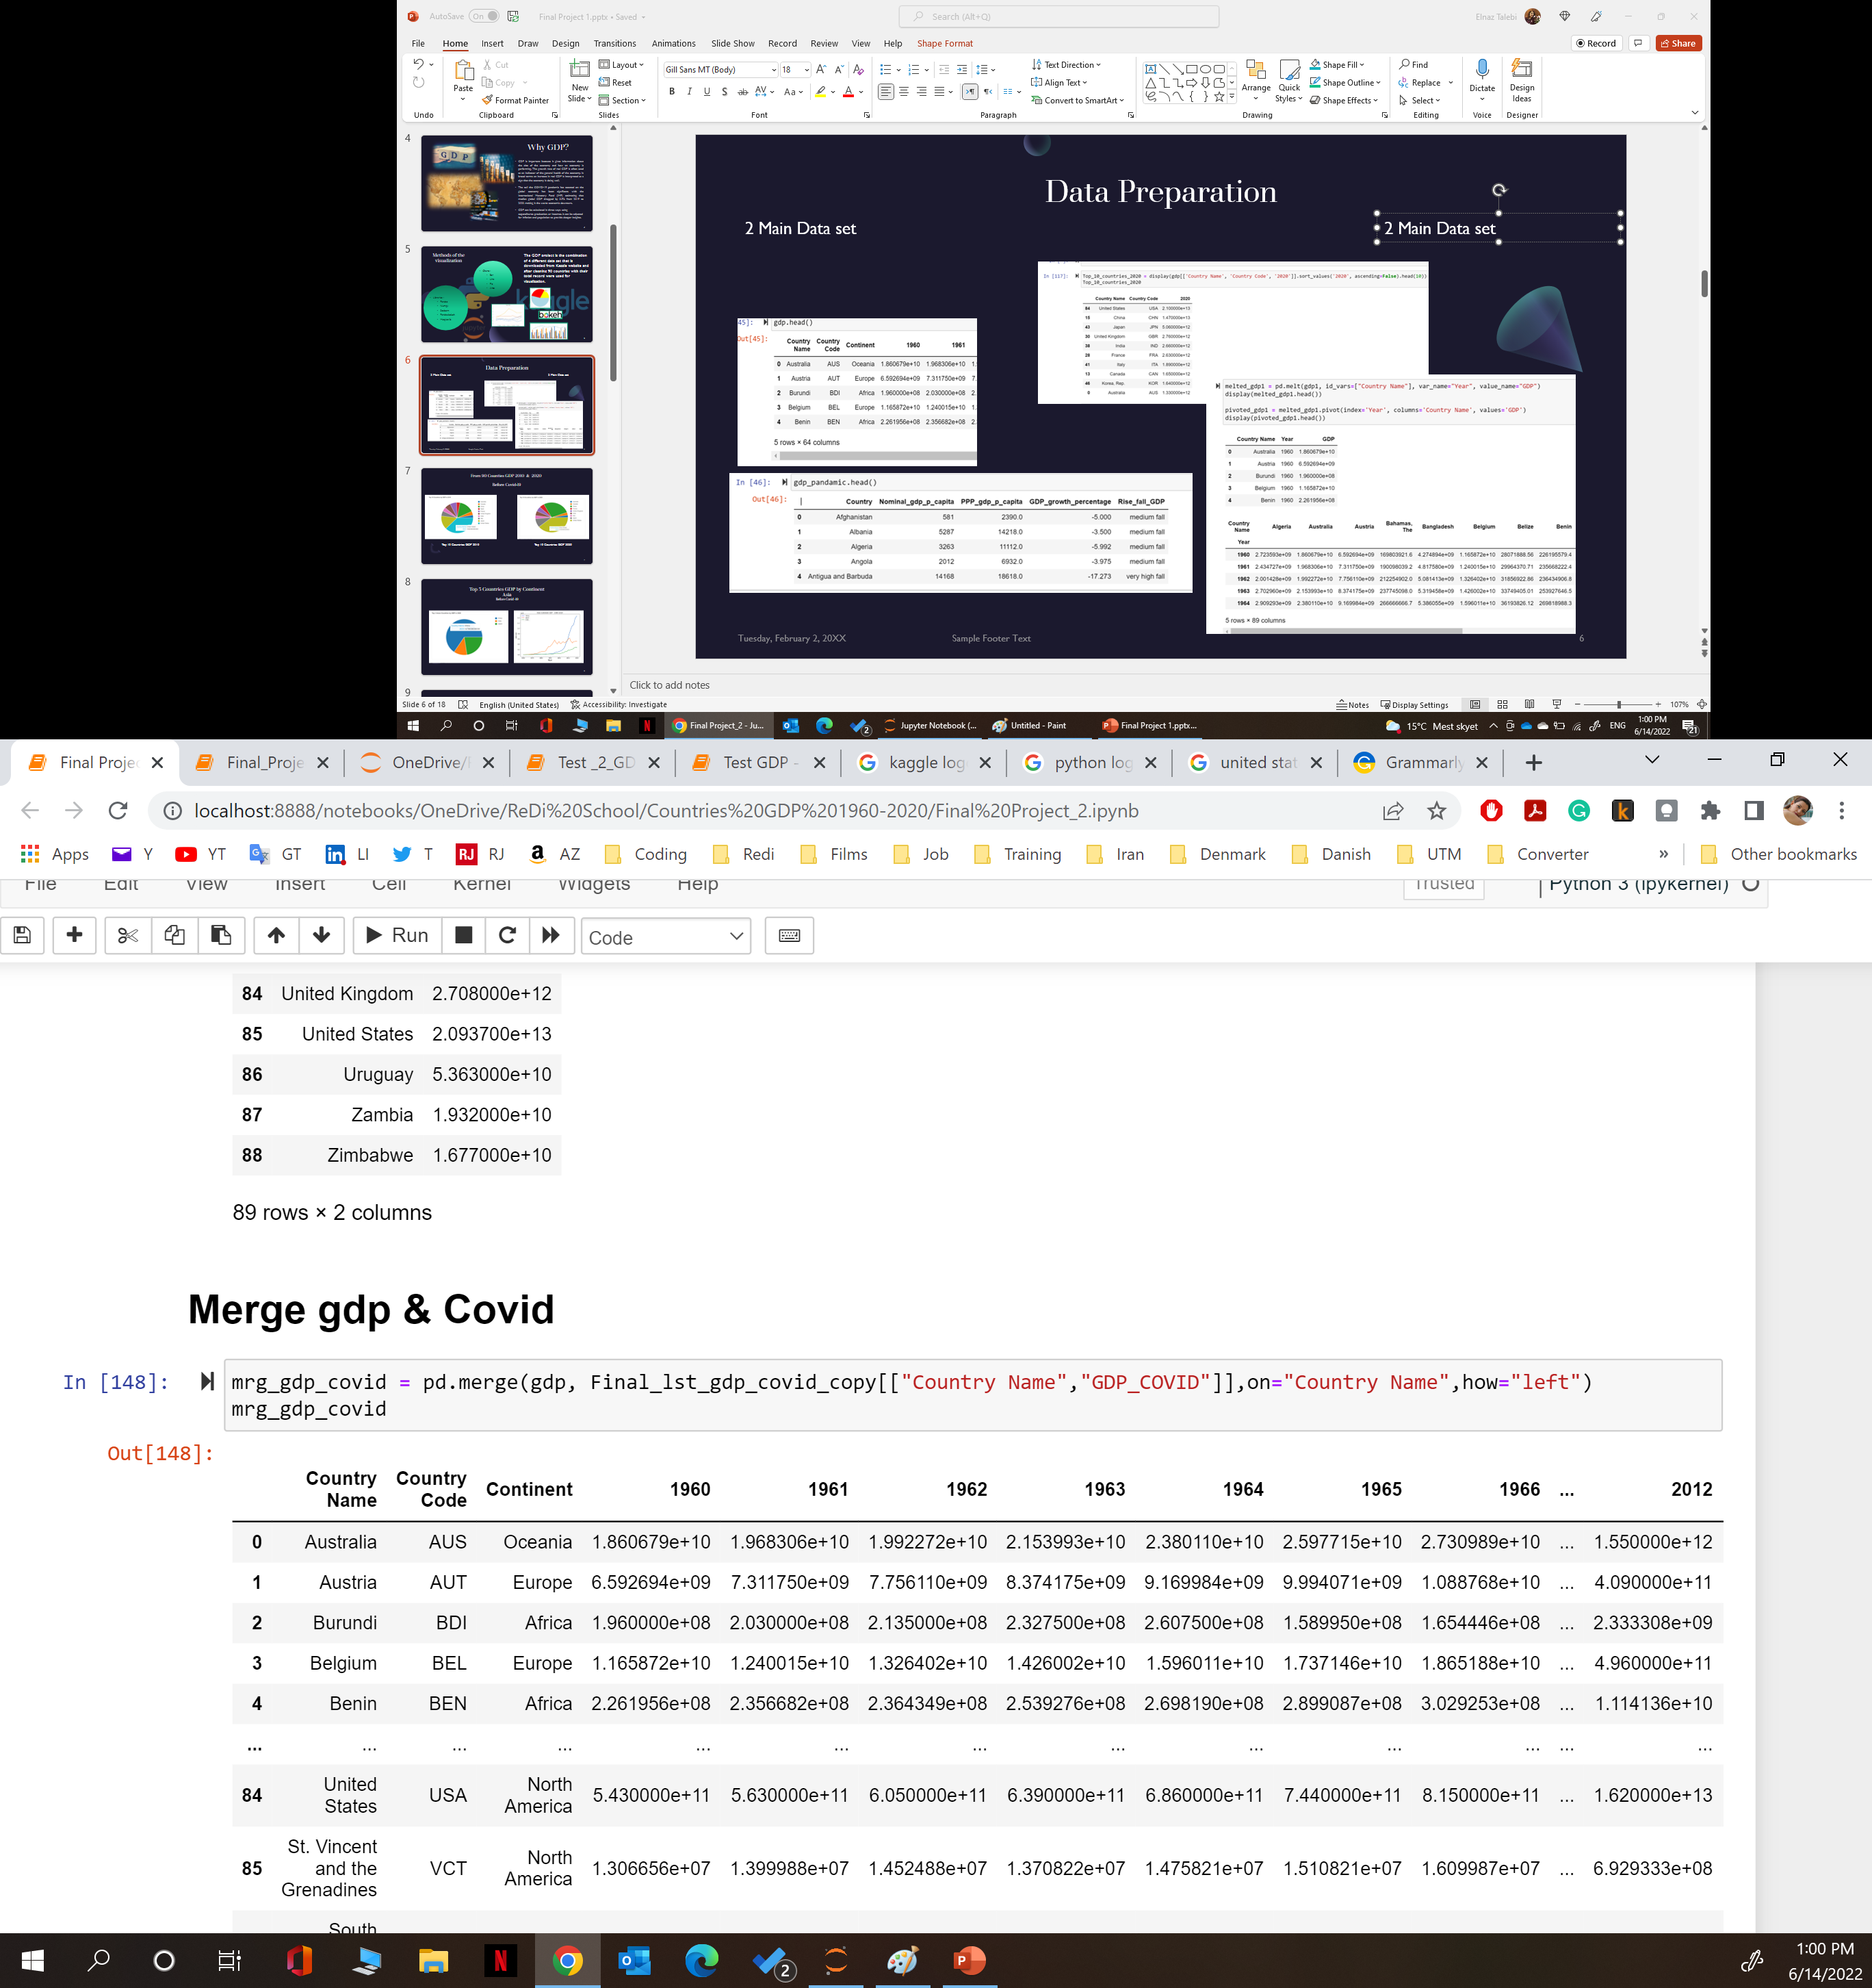
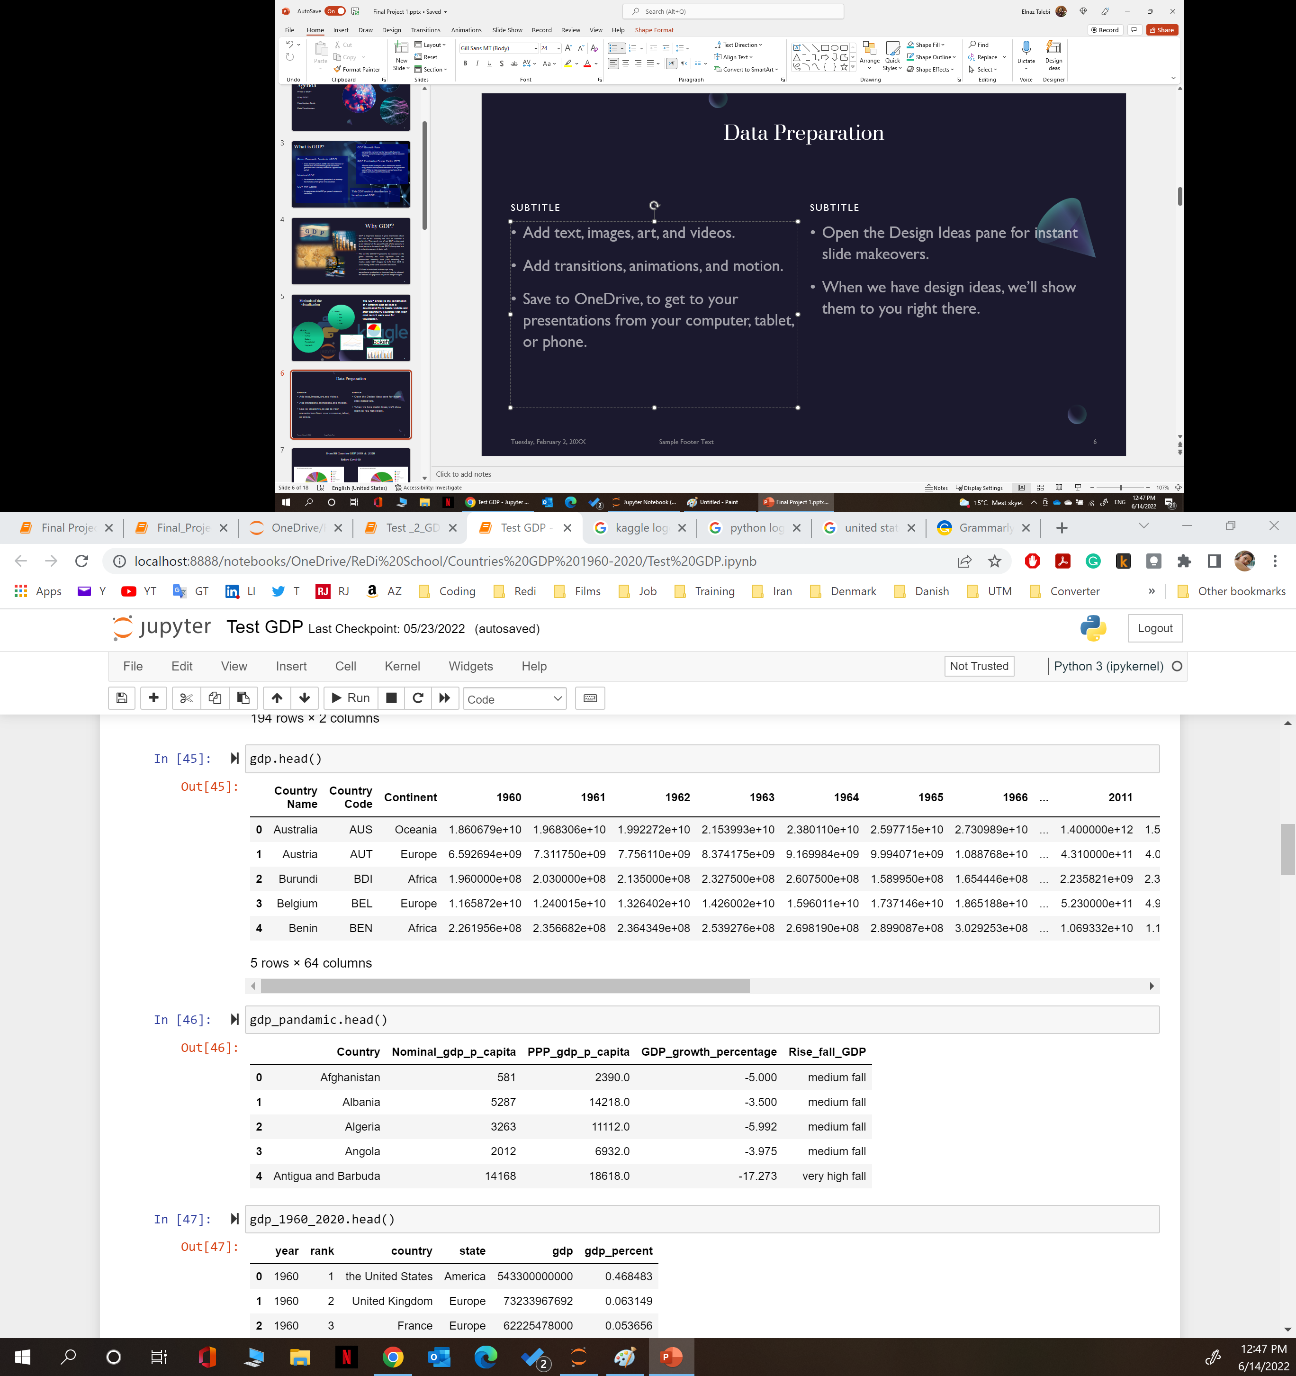
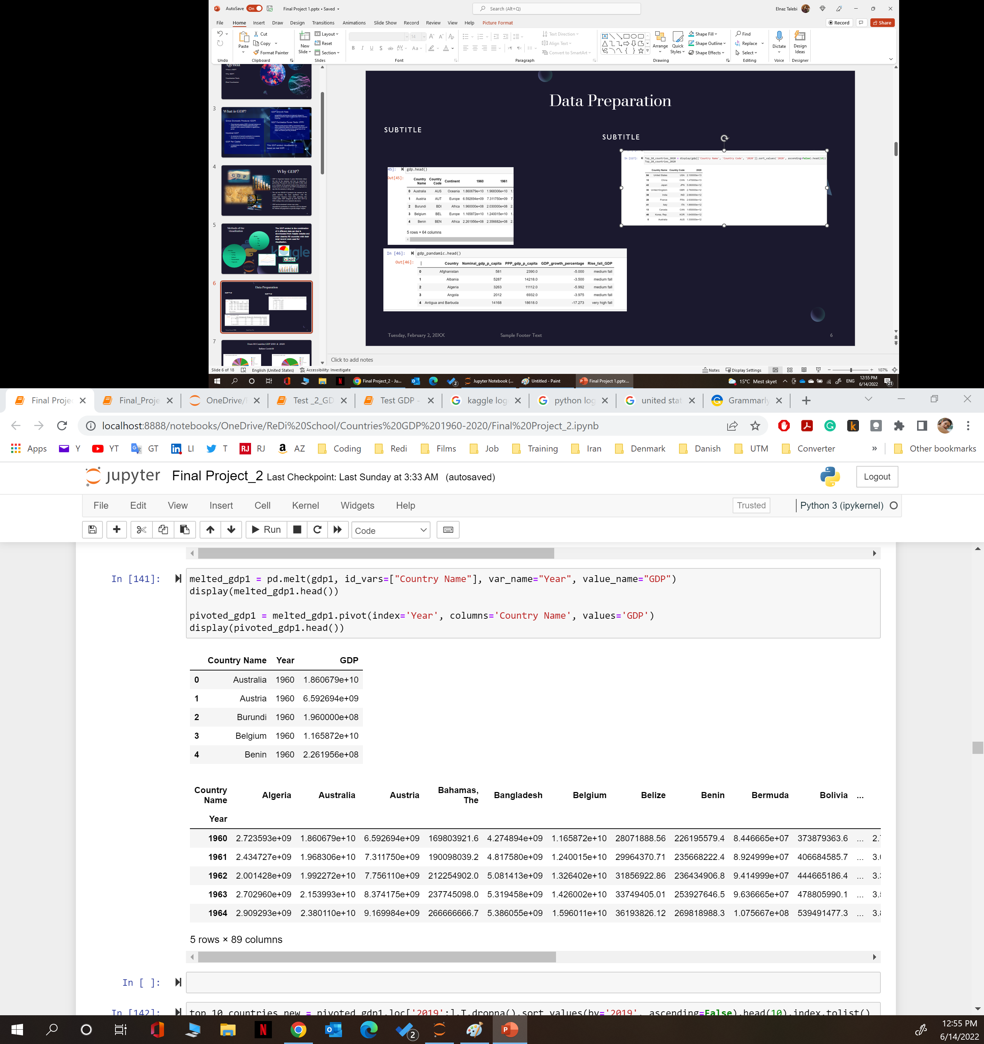
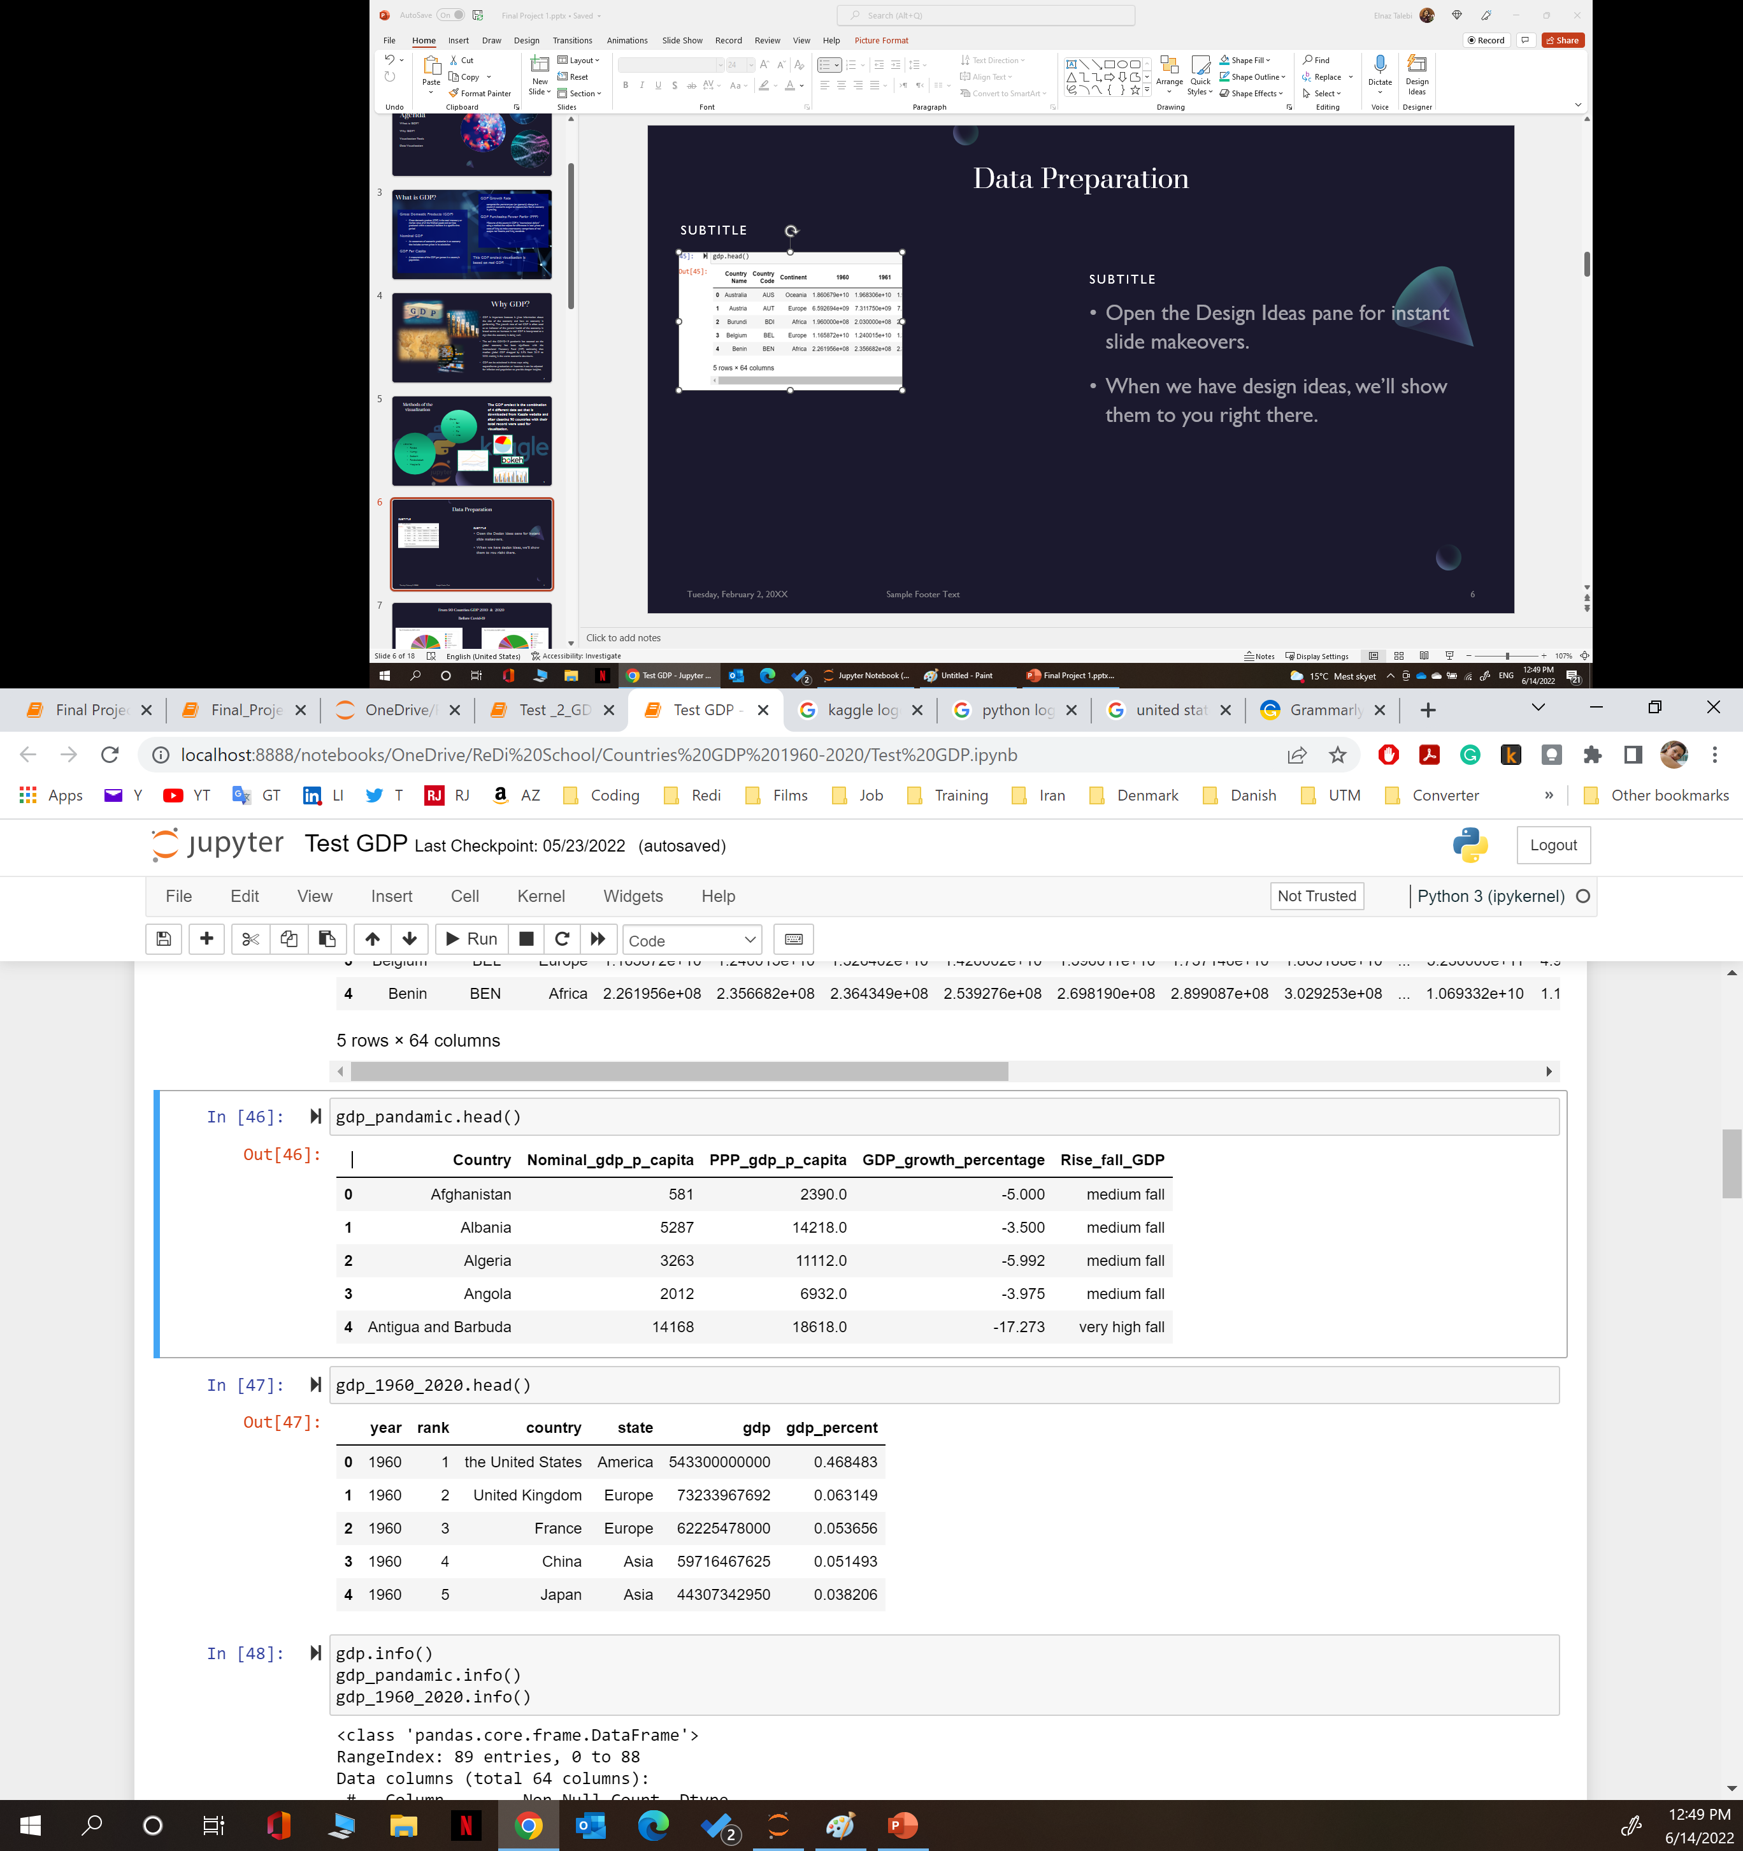
Data Preparation
2 Main Data set
2 Most used Data set

Slide 7
Visualize Countries GDP By Continent

Slide 8
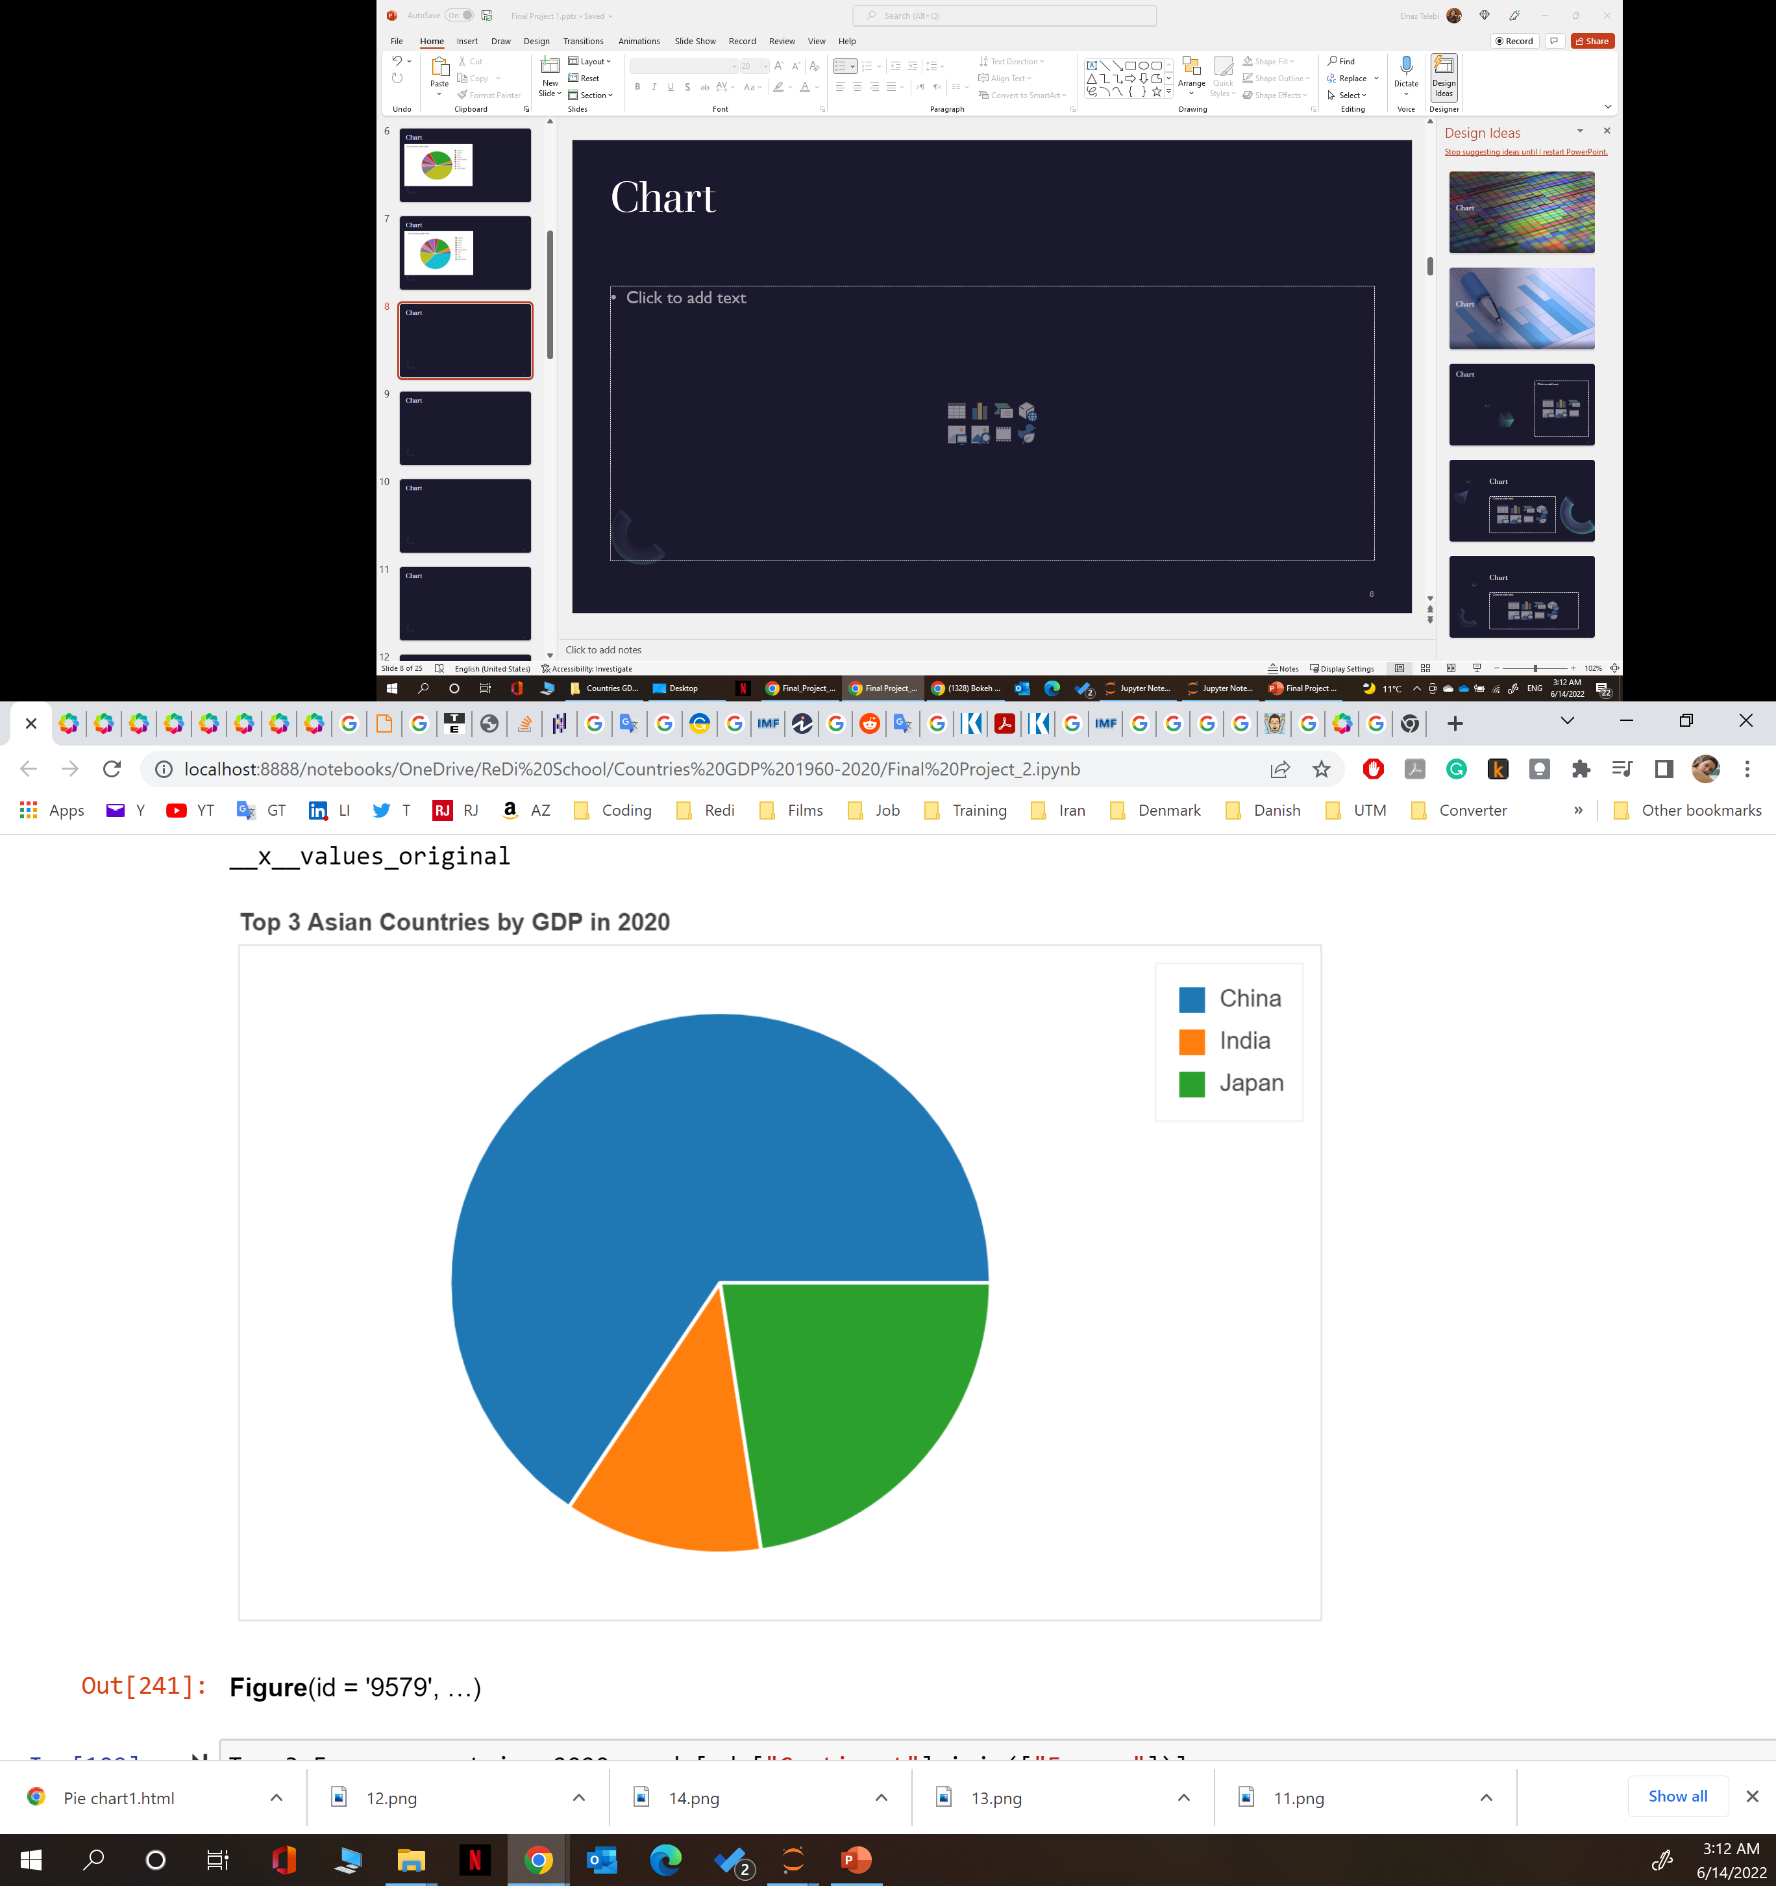
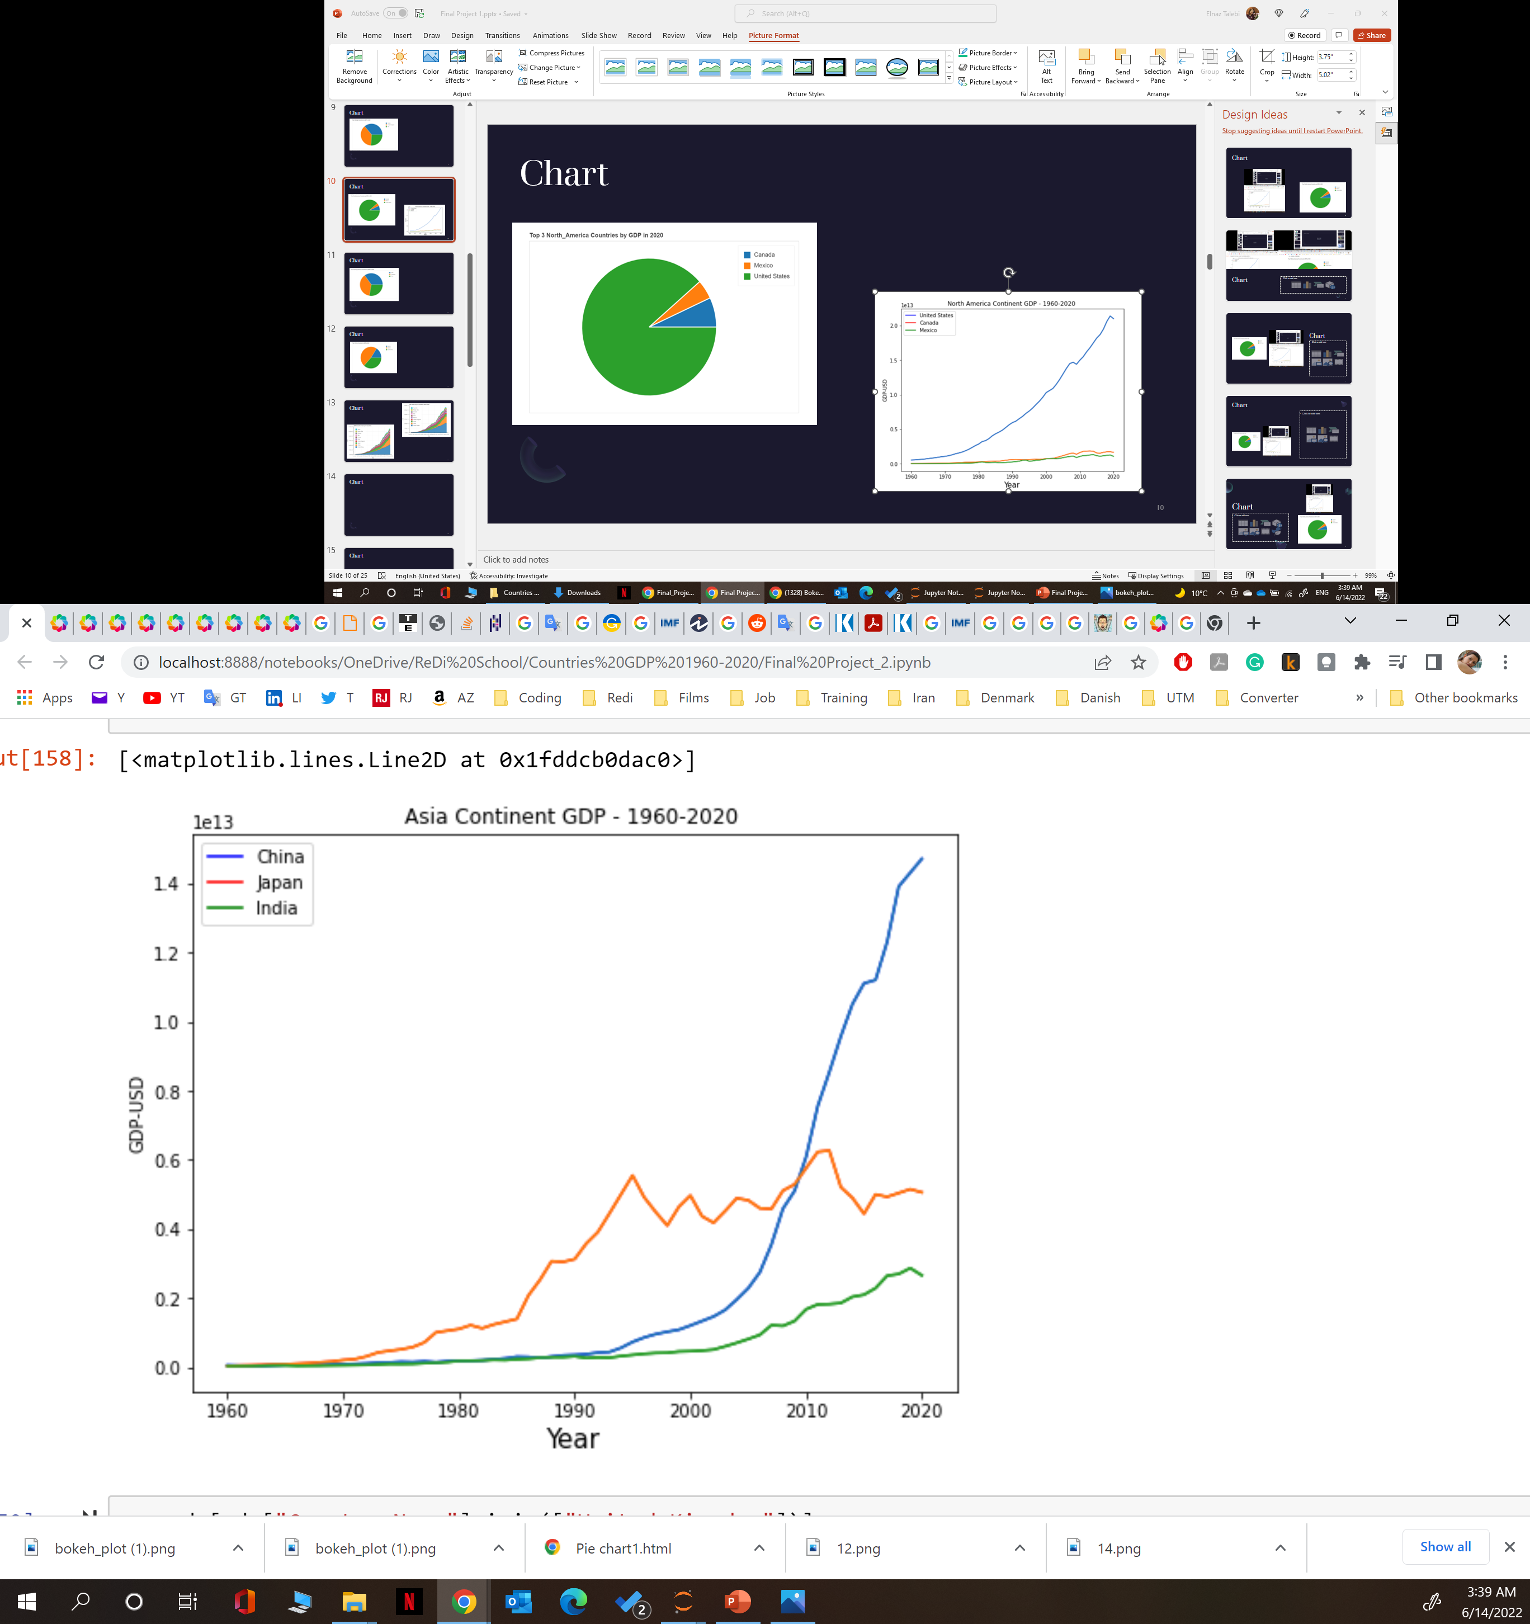
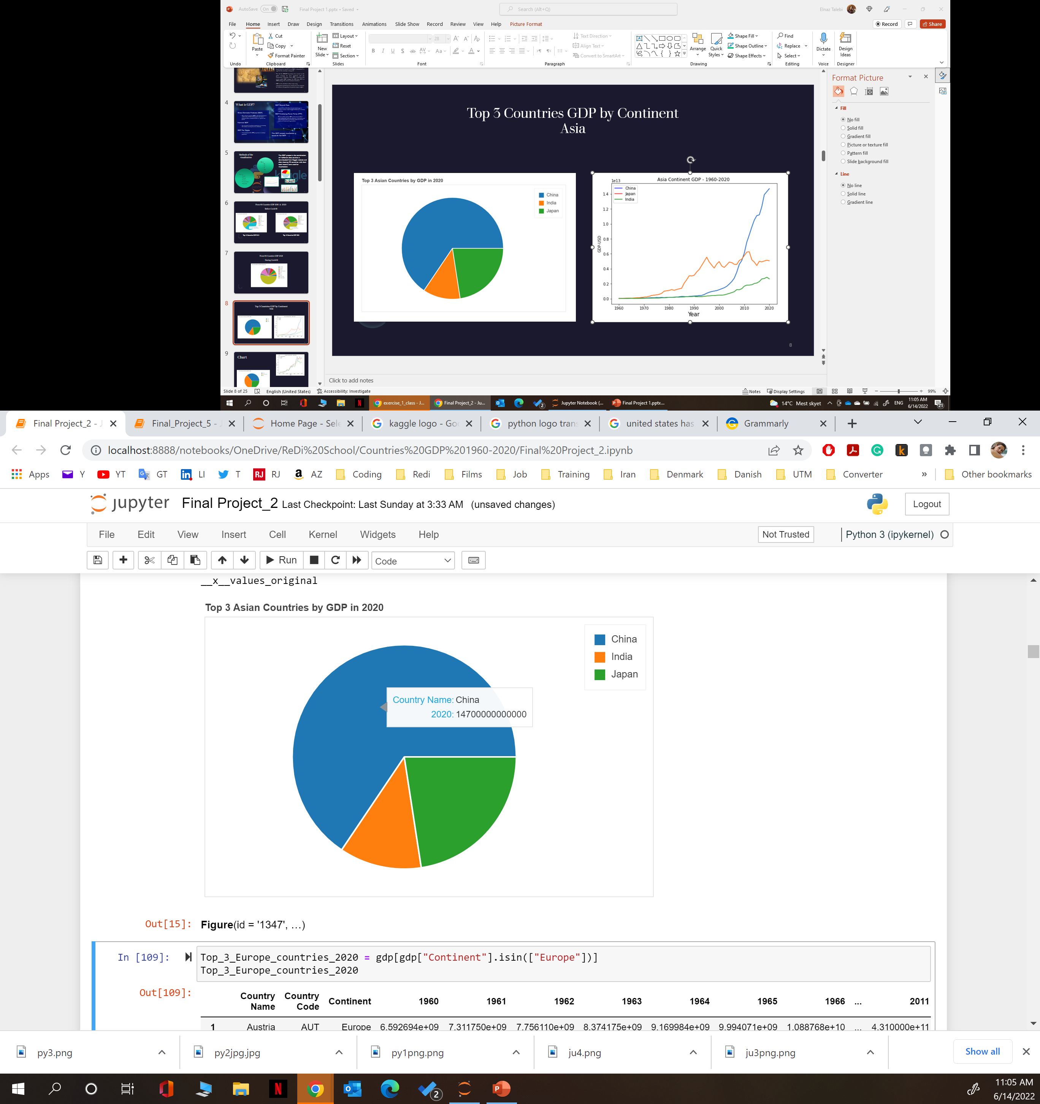
Top 3 Countries GDP by Continent Asia Before Covid -19

Slide 9
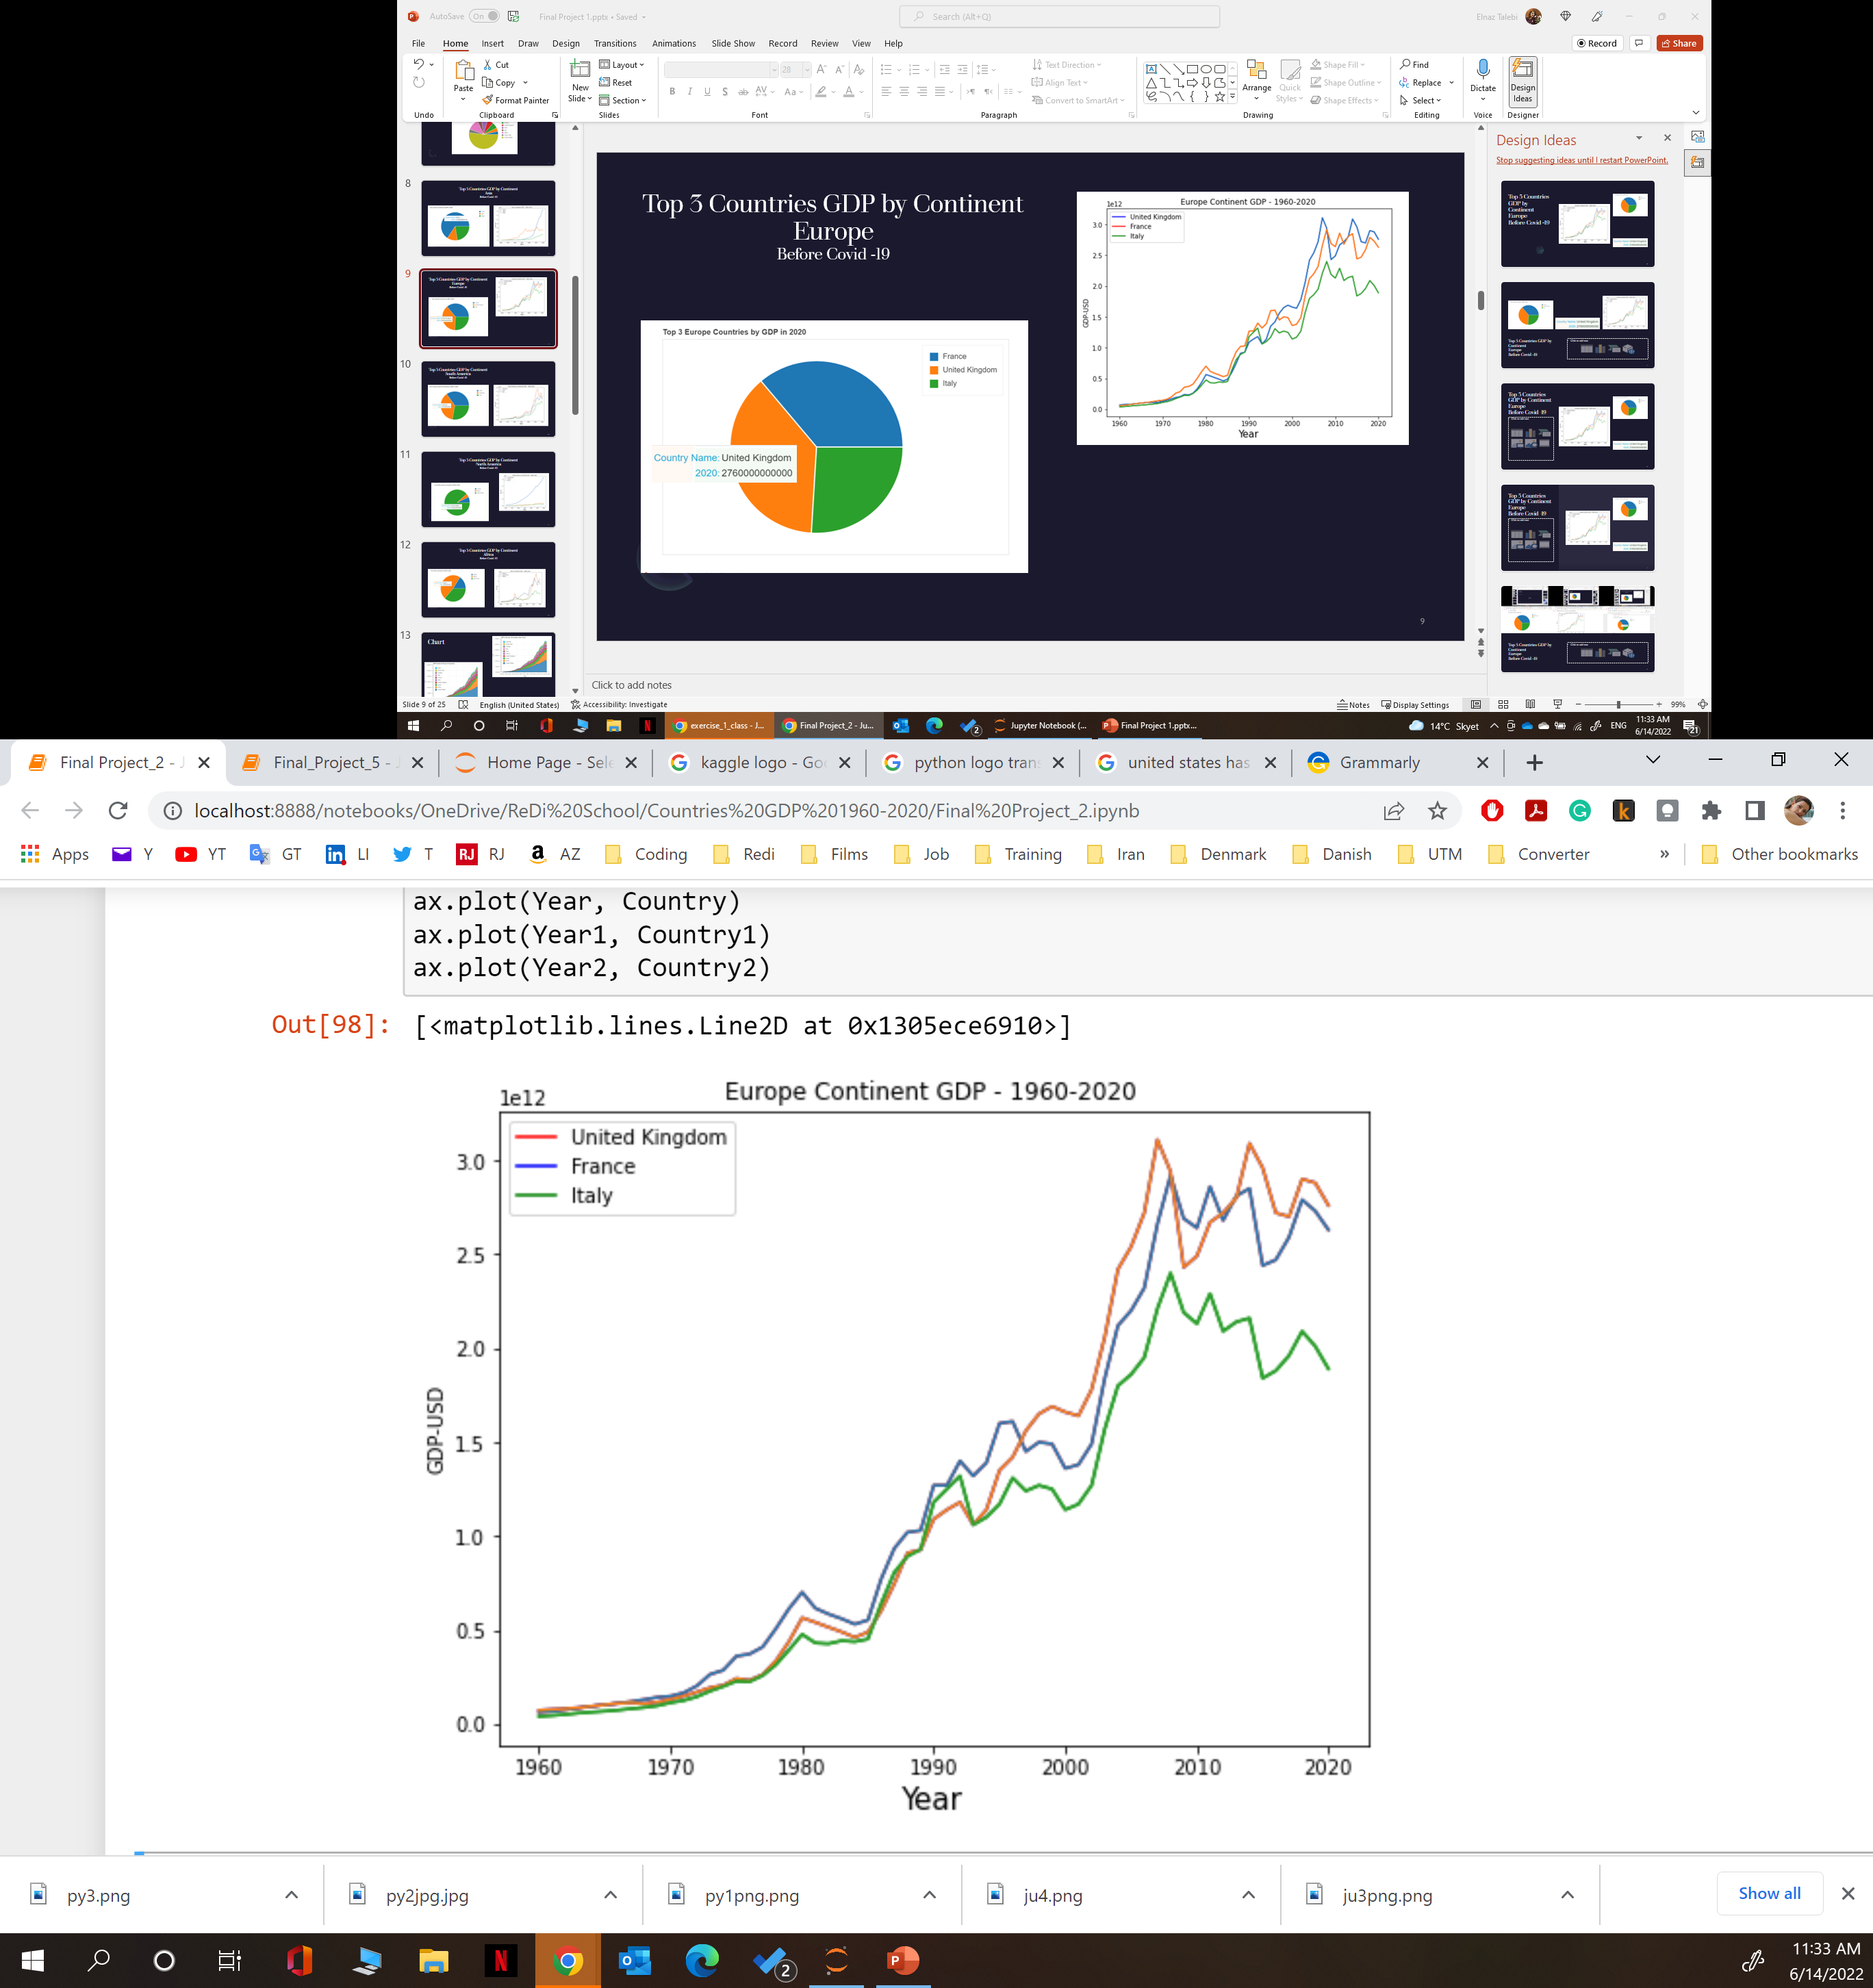
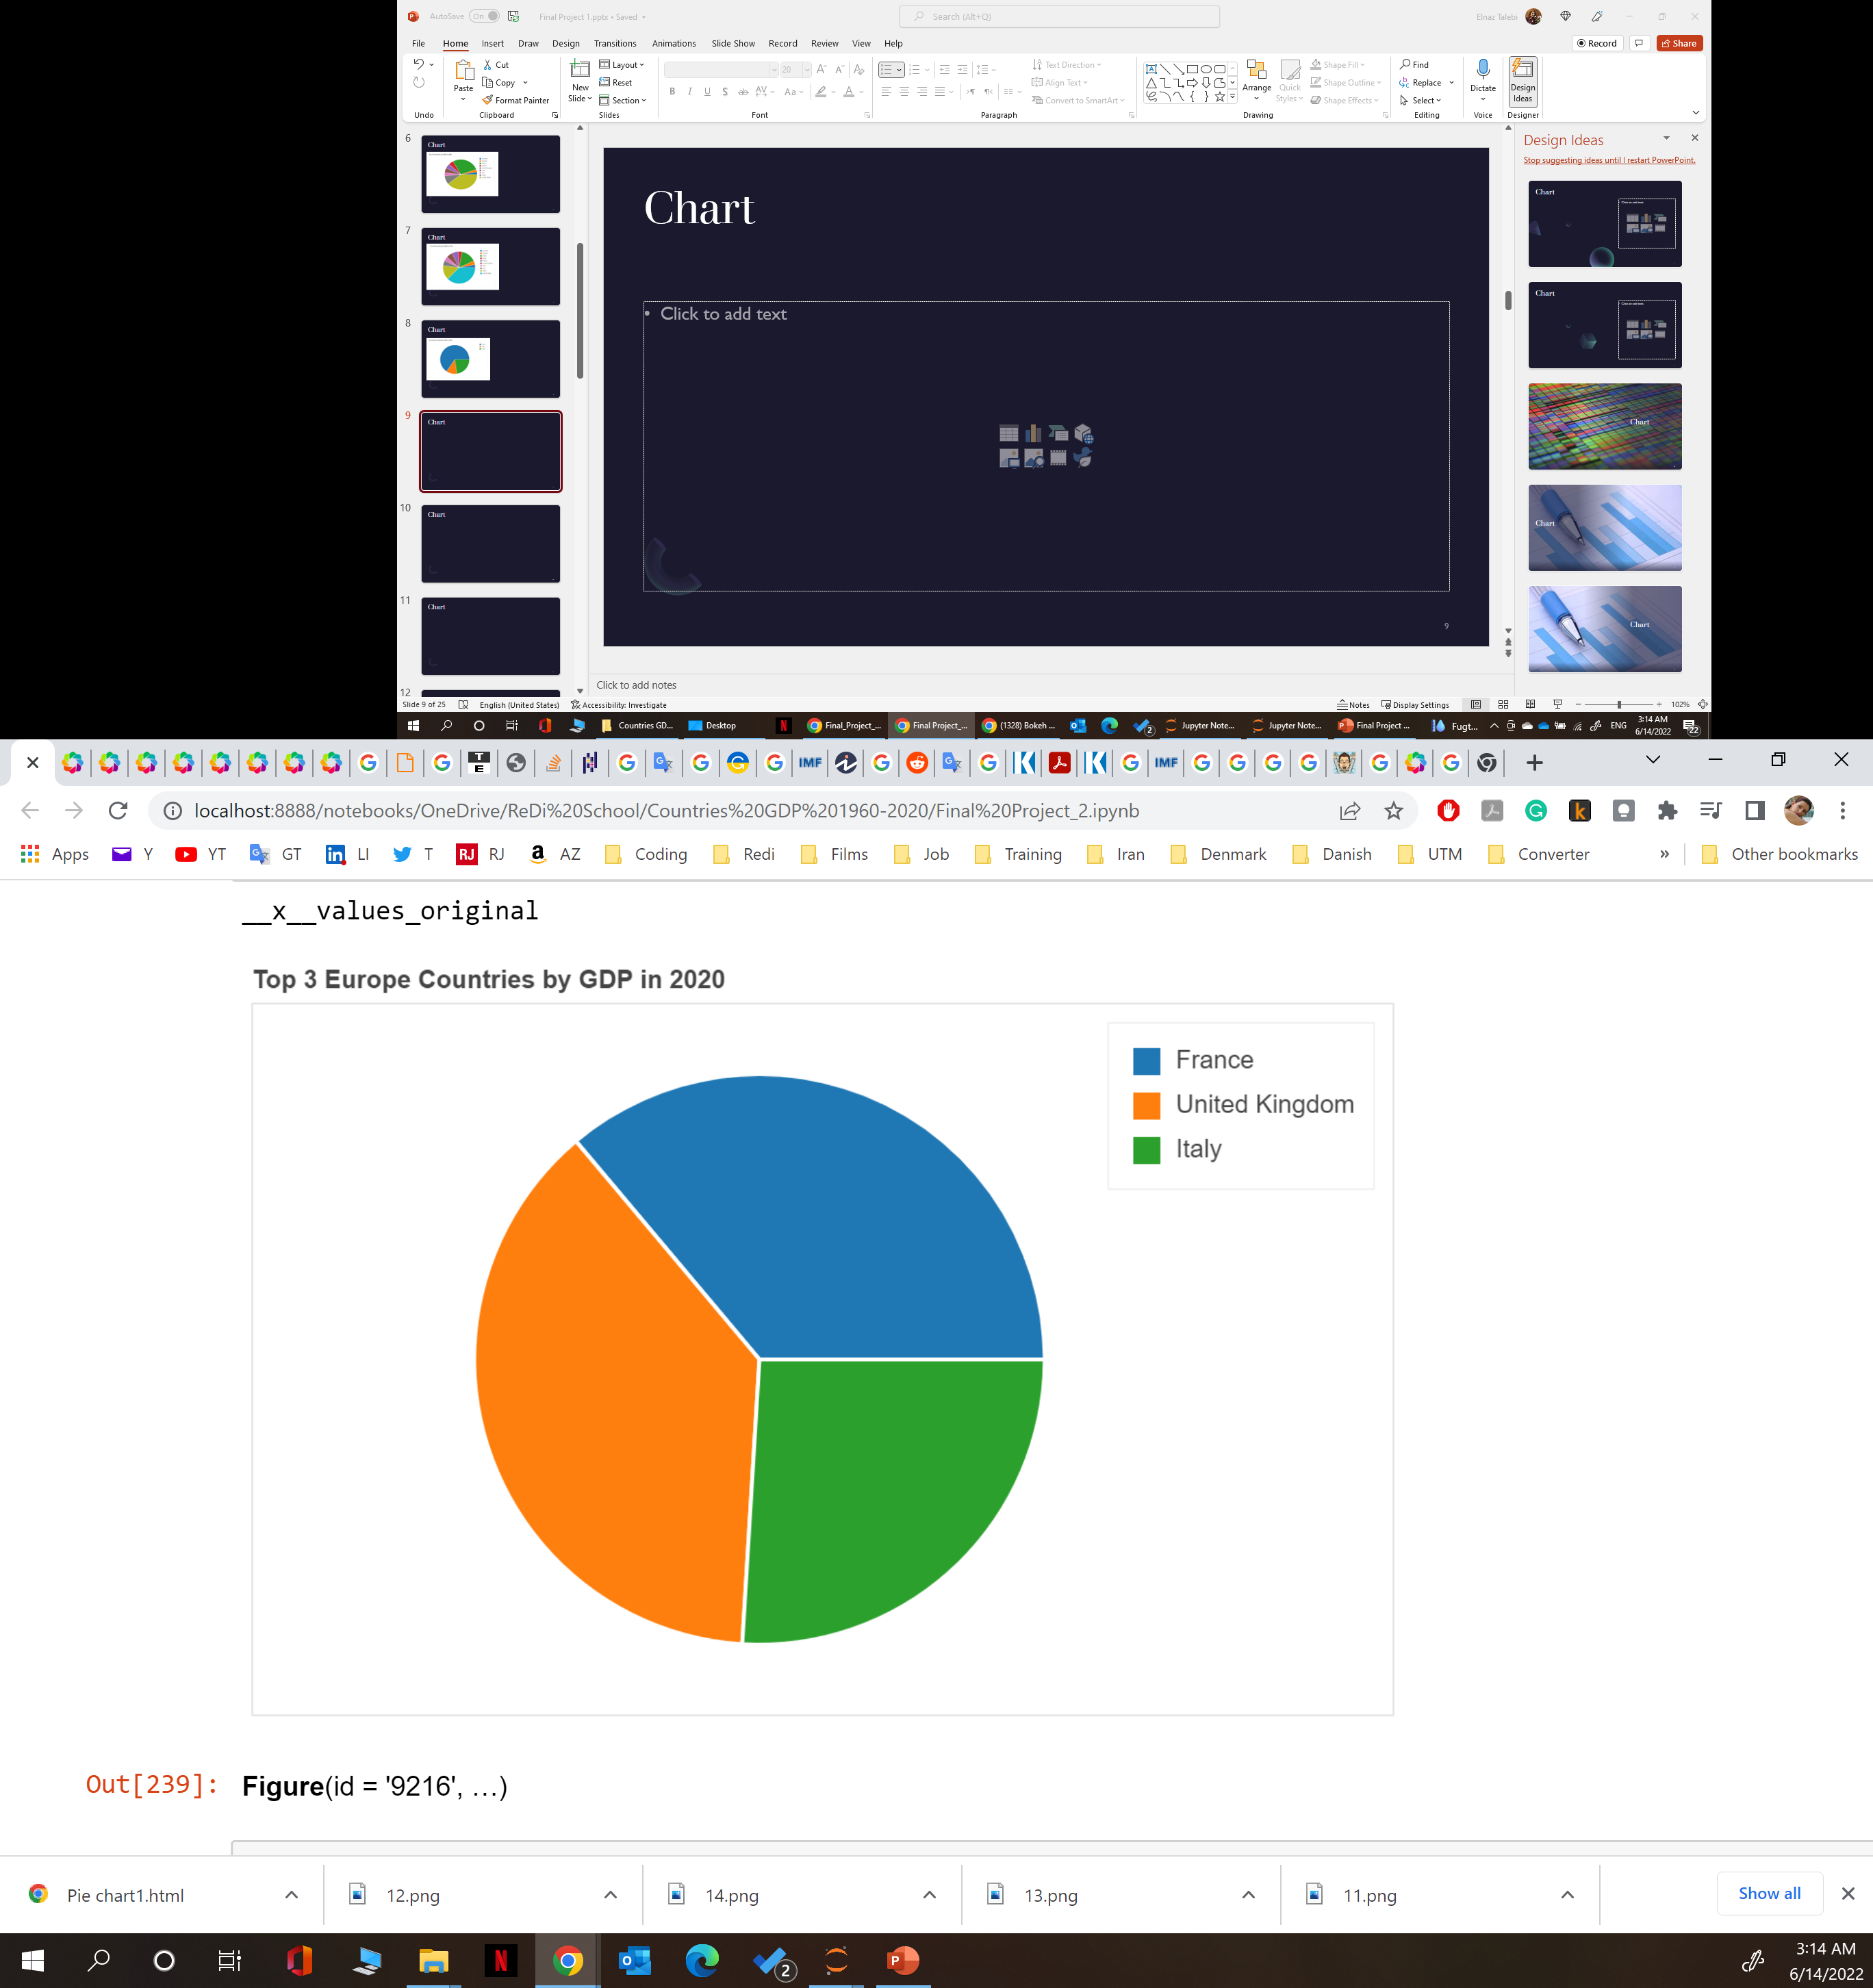
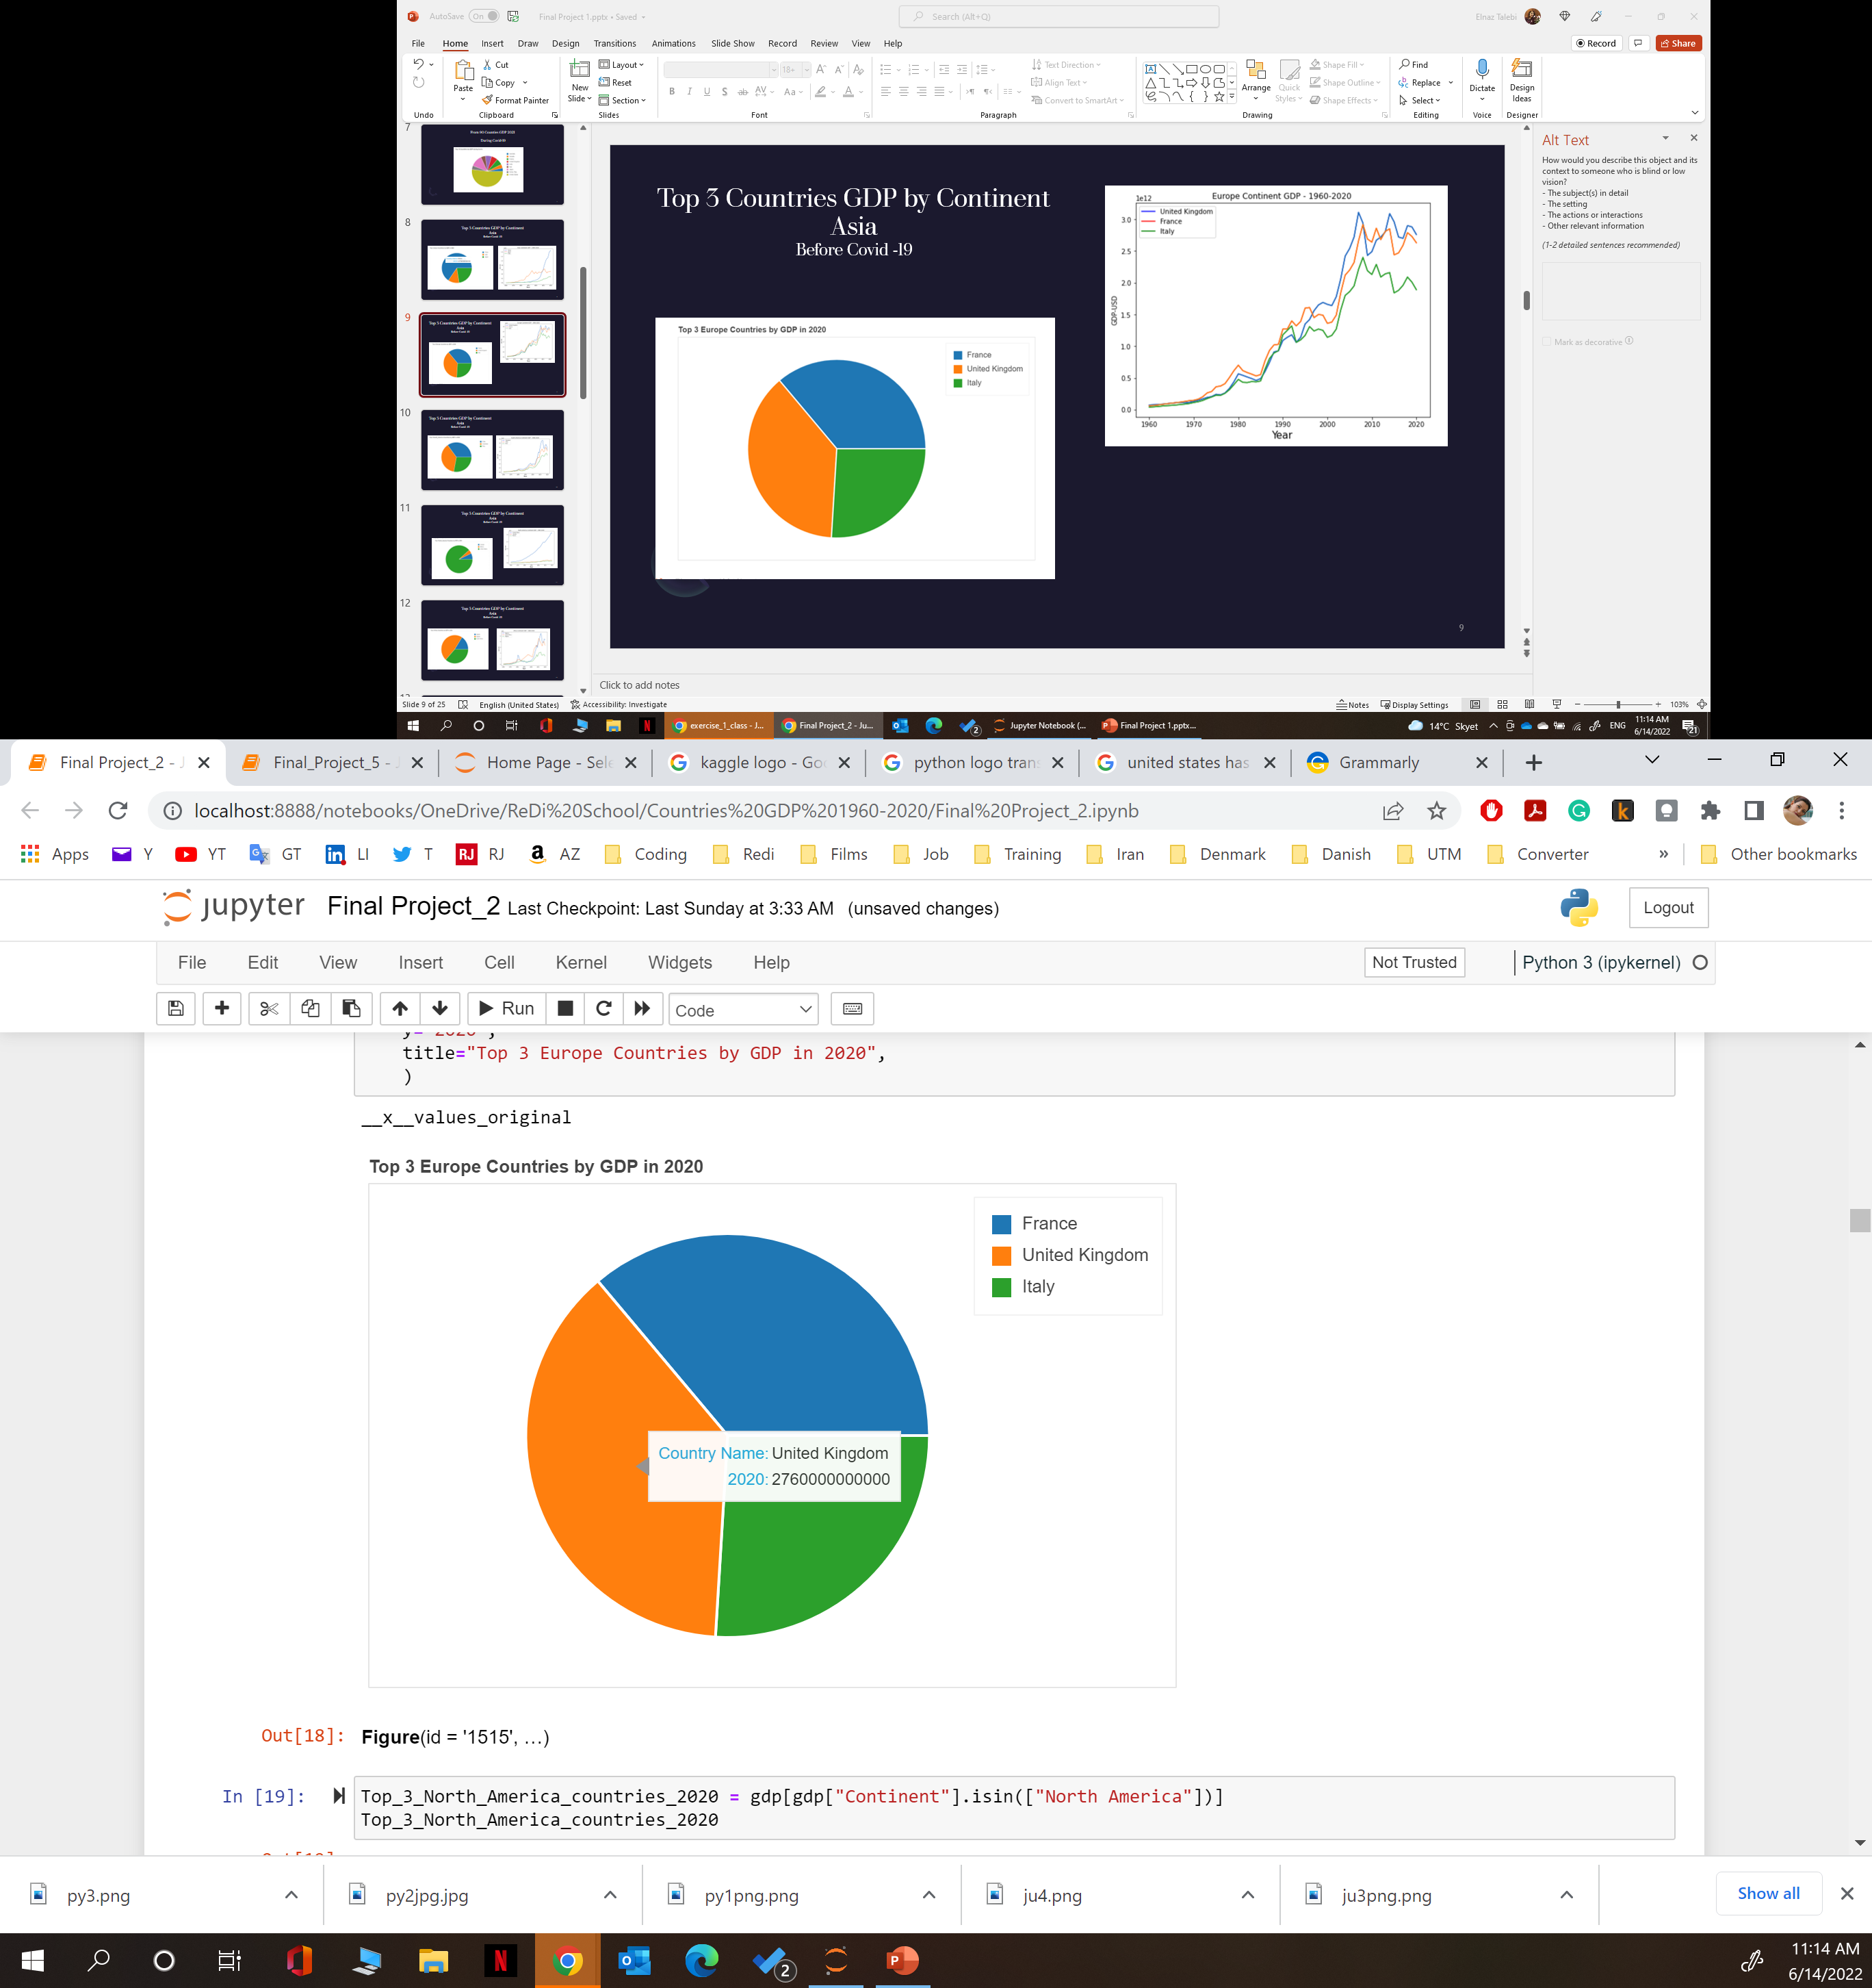
Top 3 Countries GDP by Continent Europe Before Covid -19

Slide 10
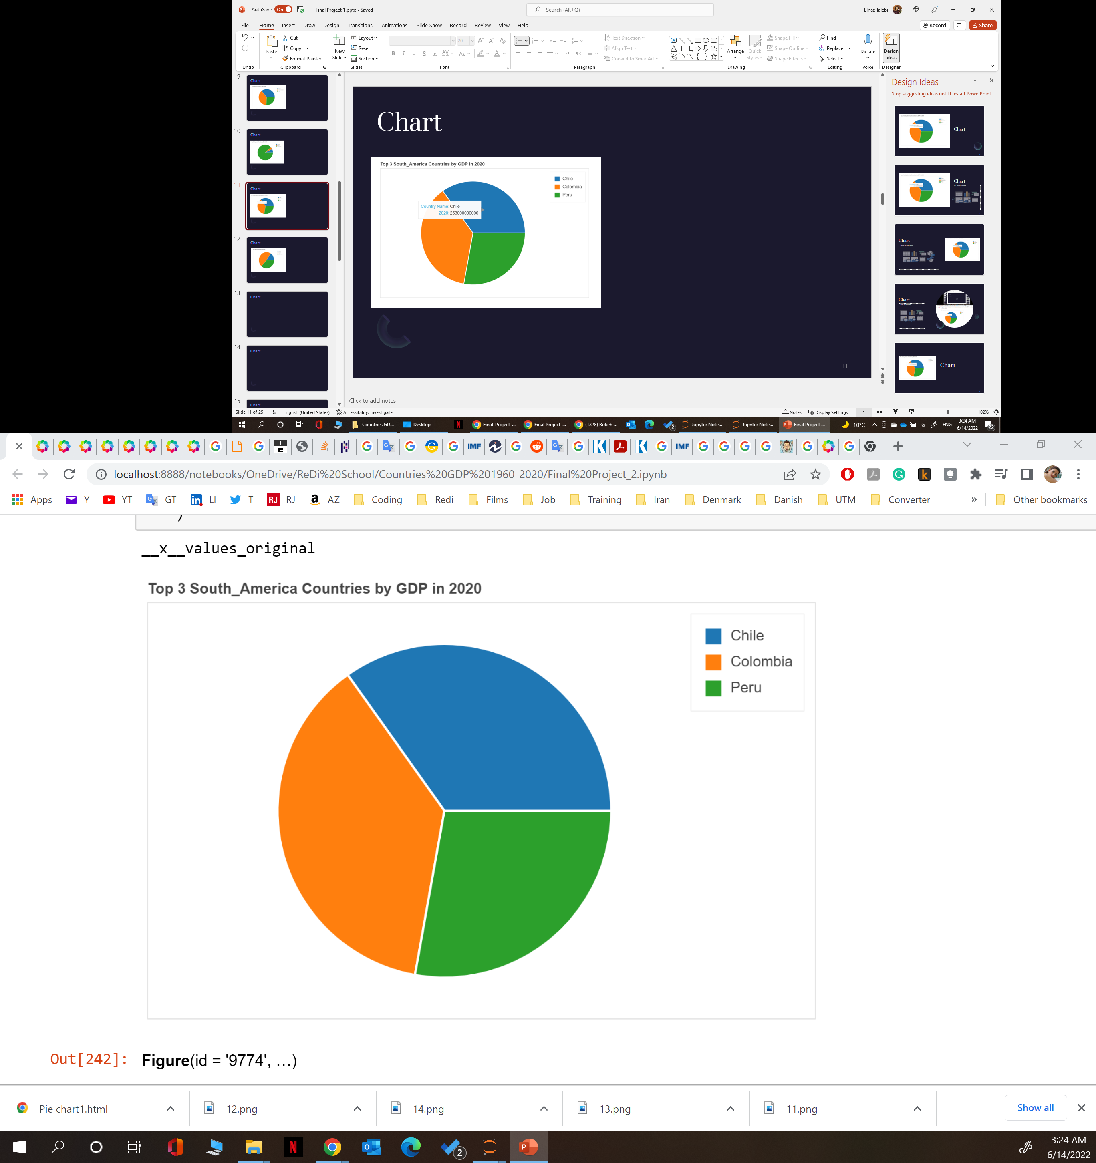
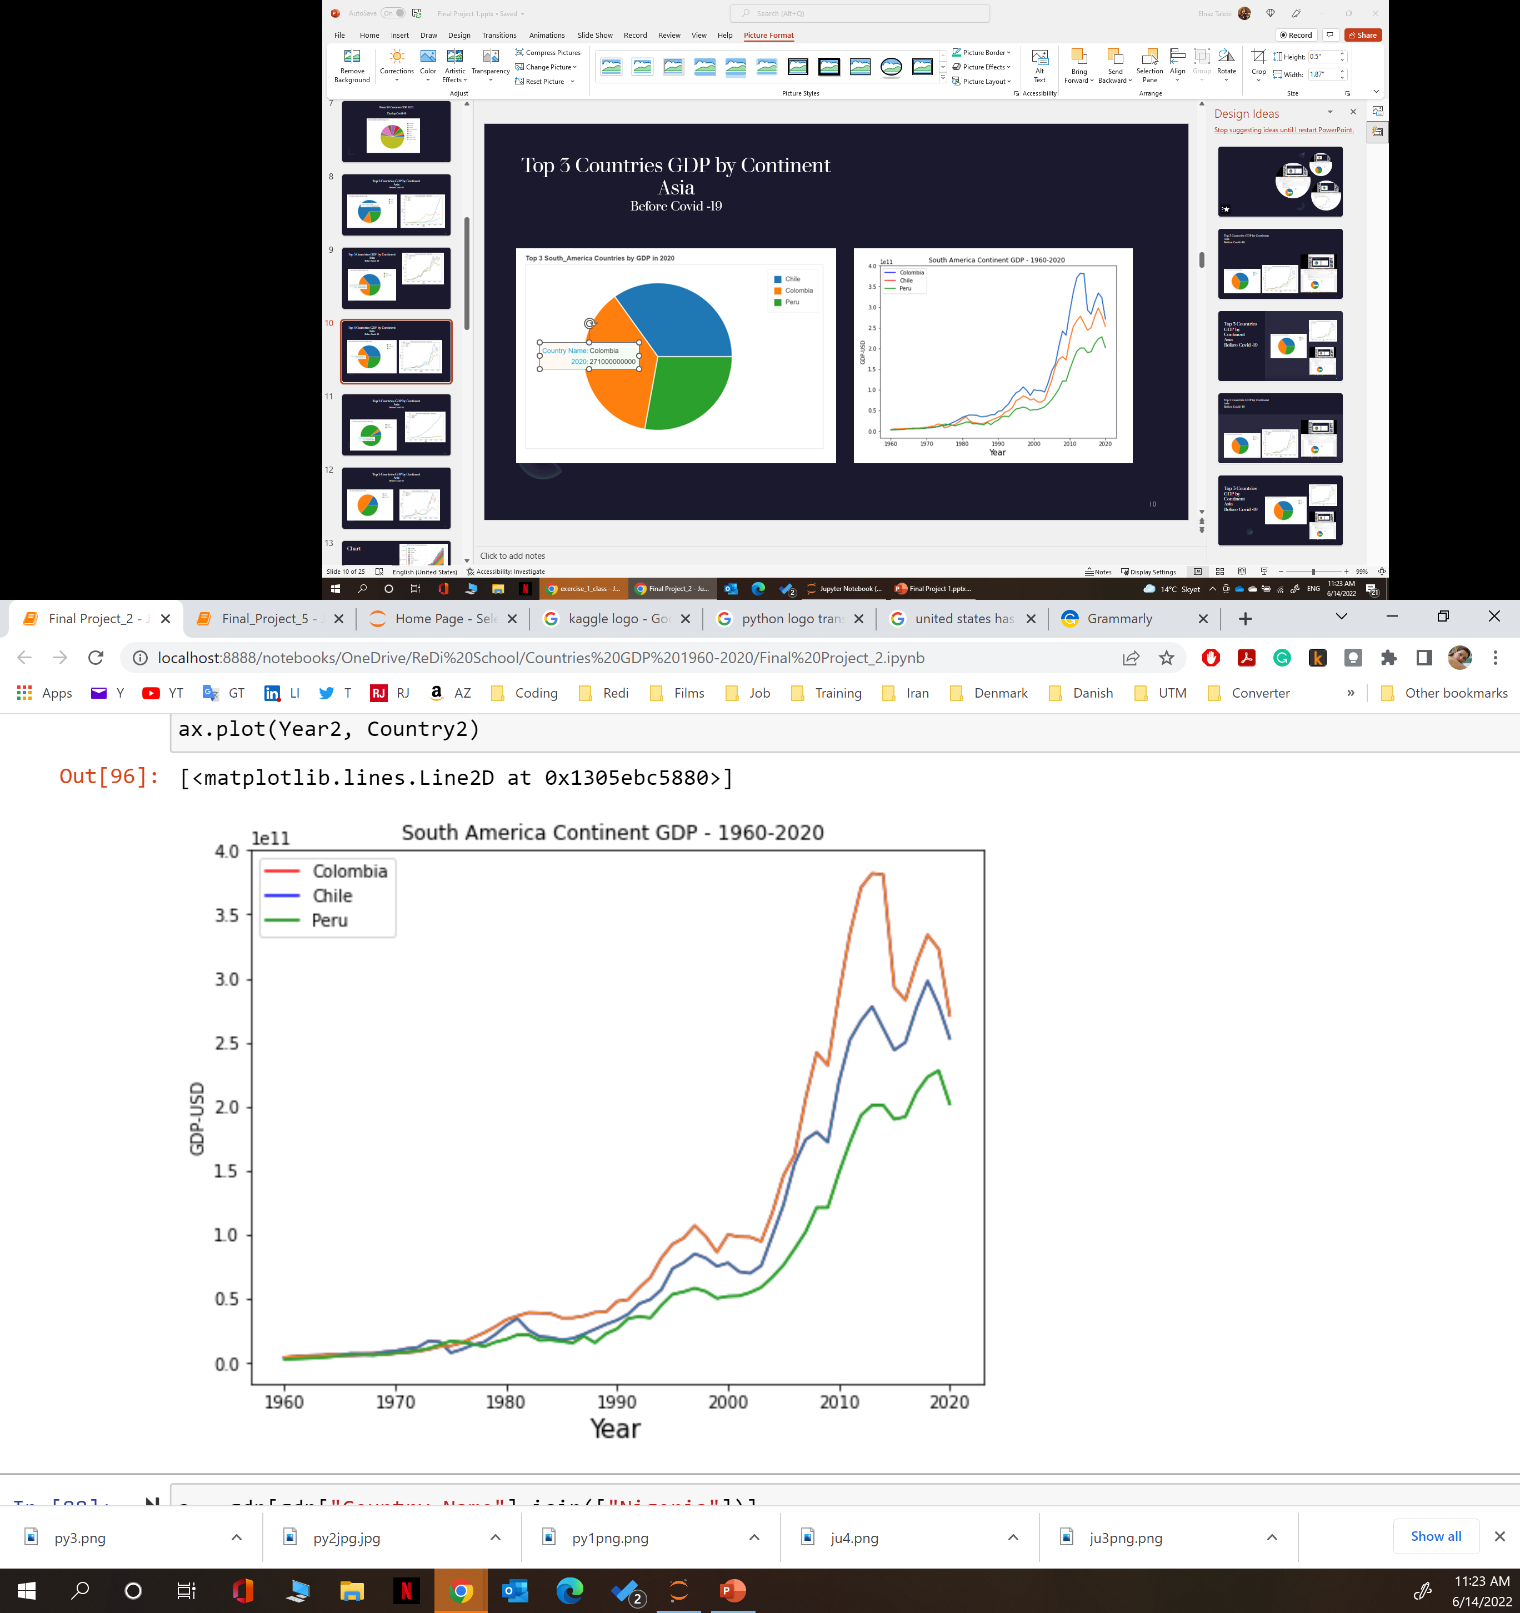
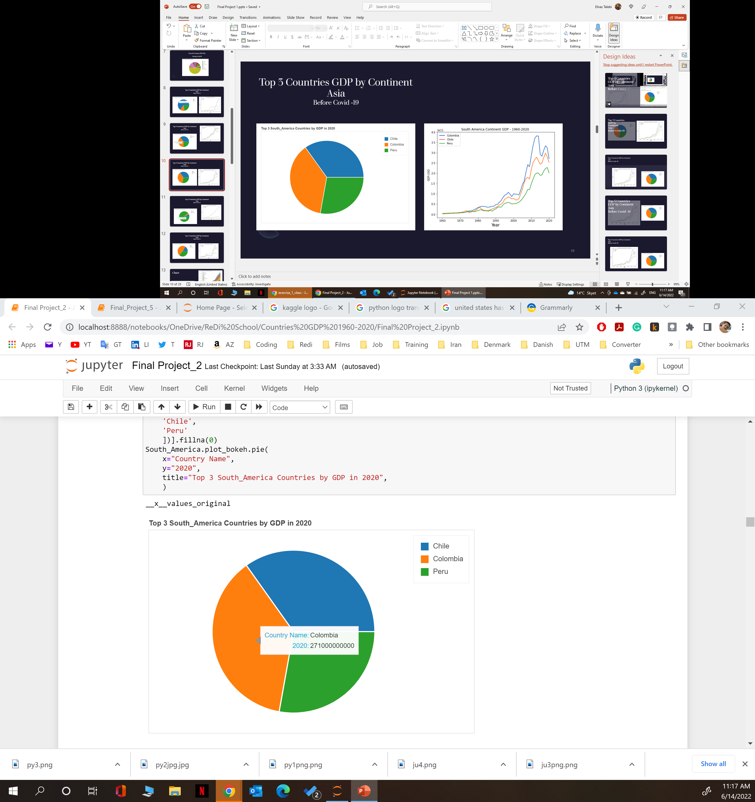
Top 3 Countries GDP by Continent South America Before Covid -19

Slide 11
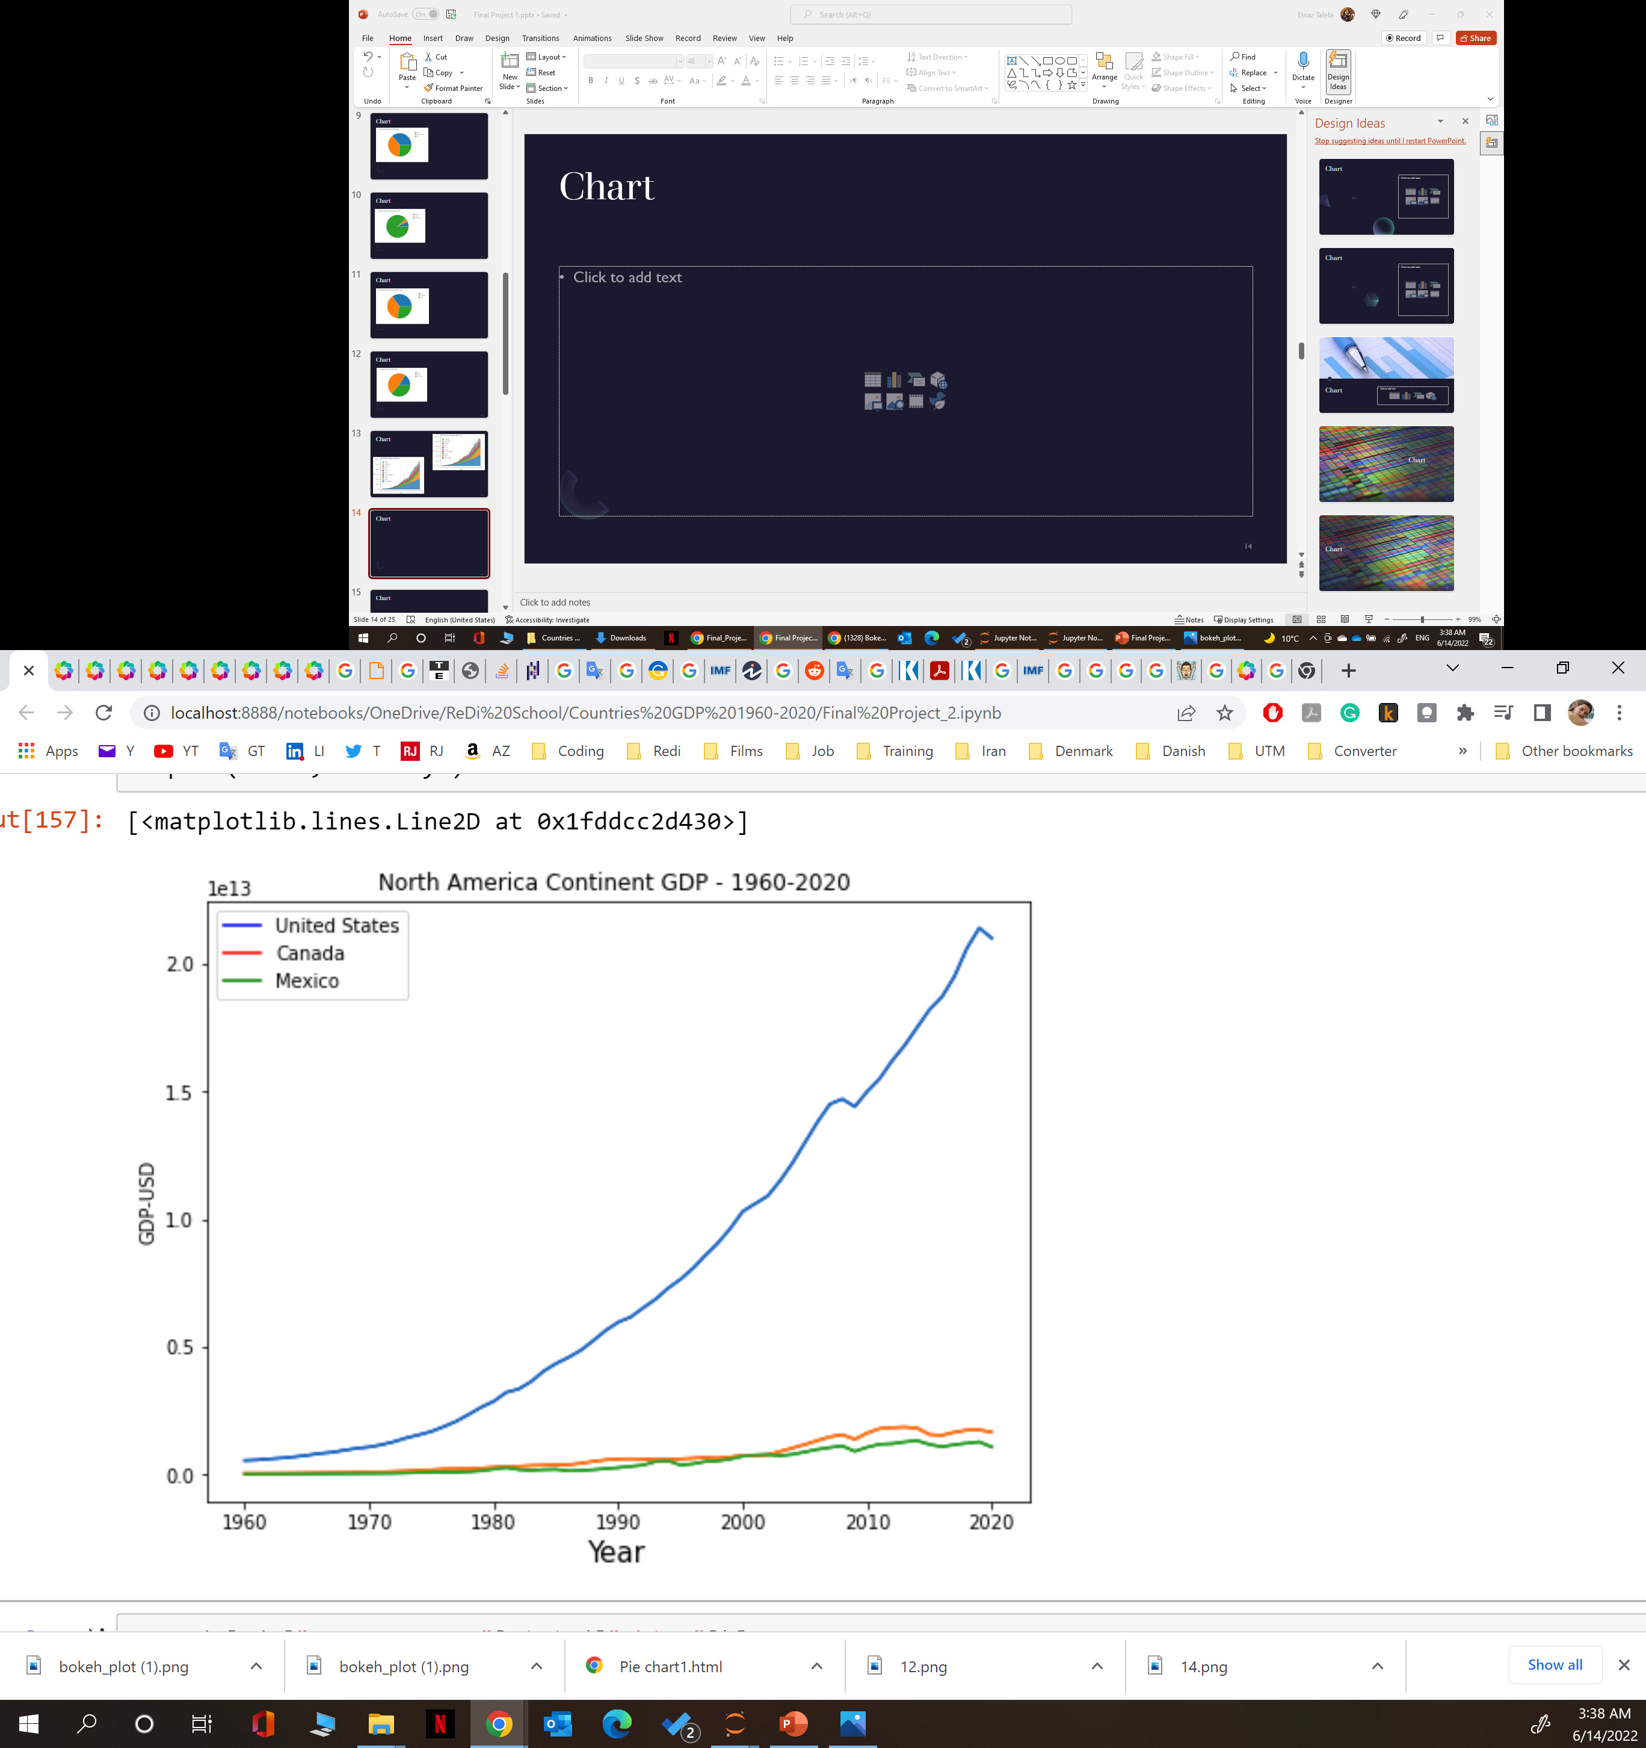
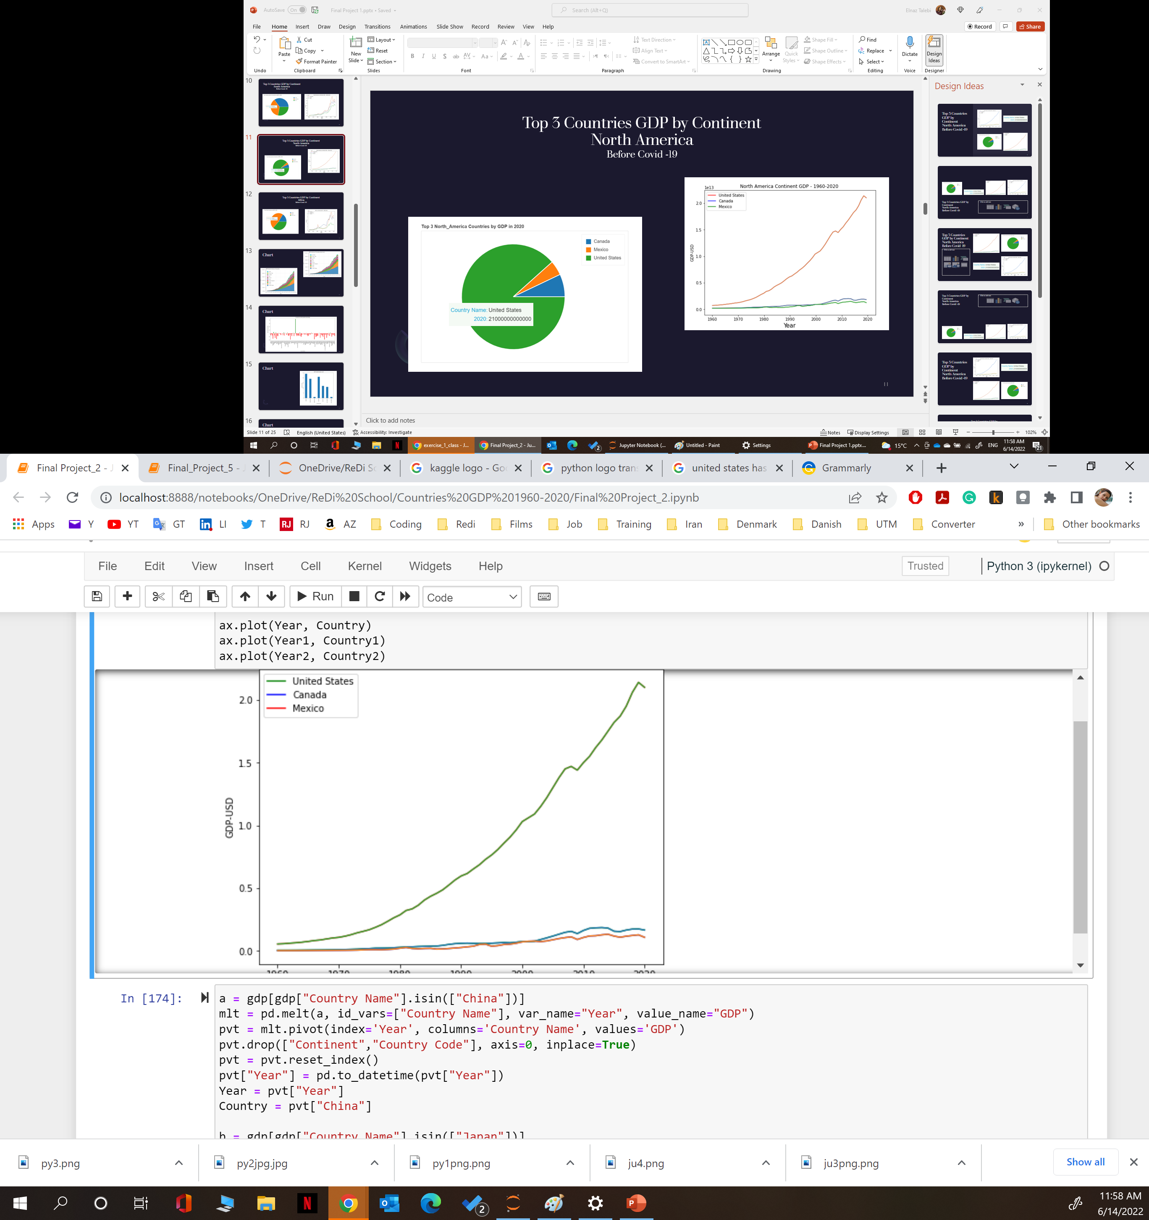
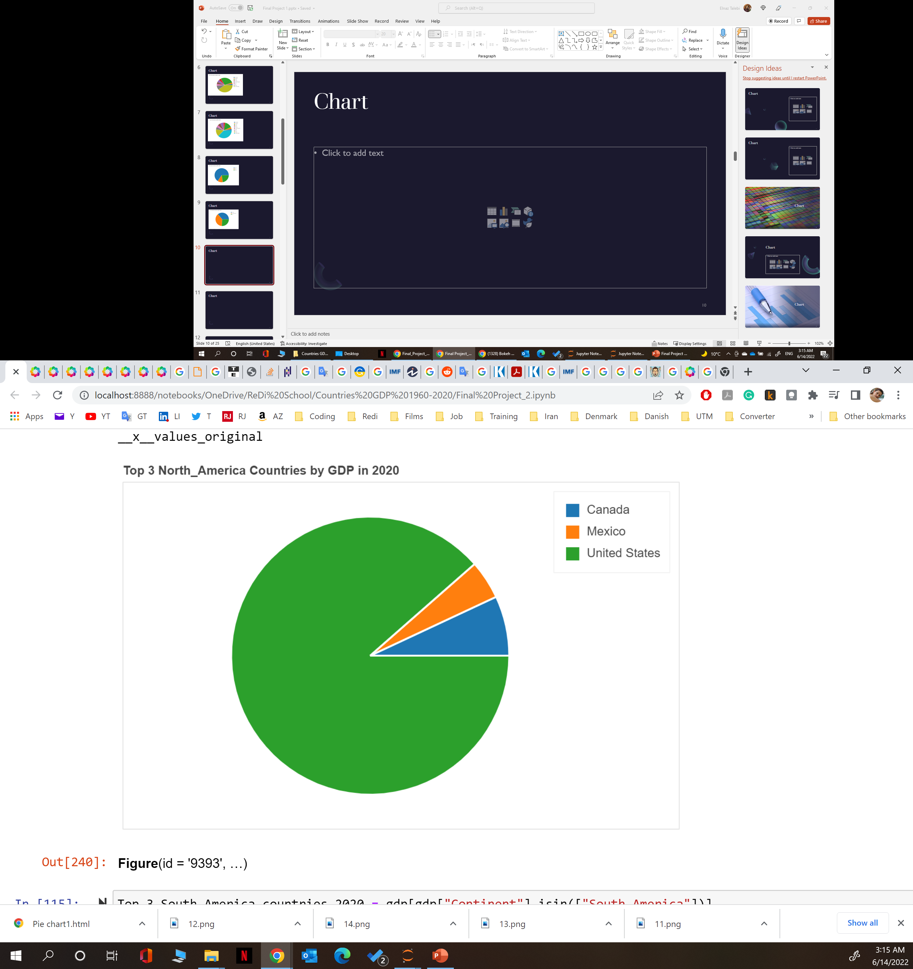
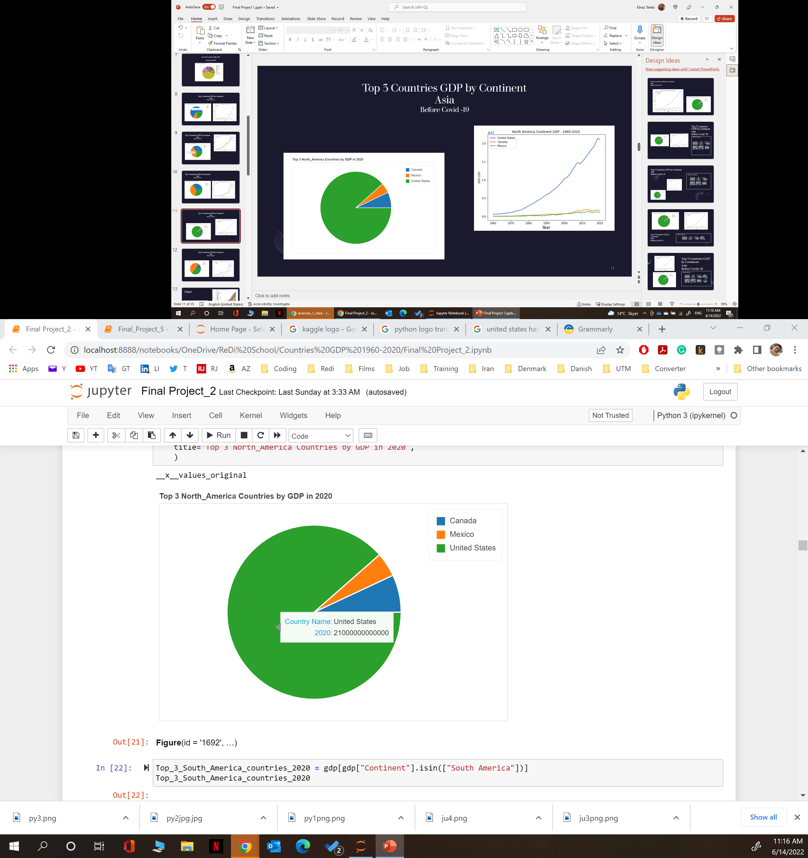
Top 3 Countries GDP by Continent North America Before Covid -19

Slide 12
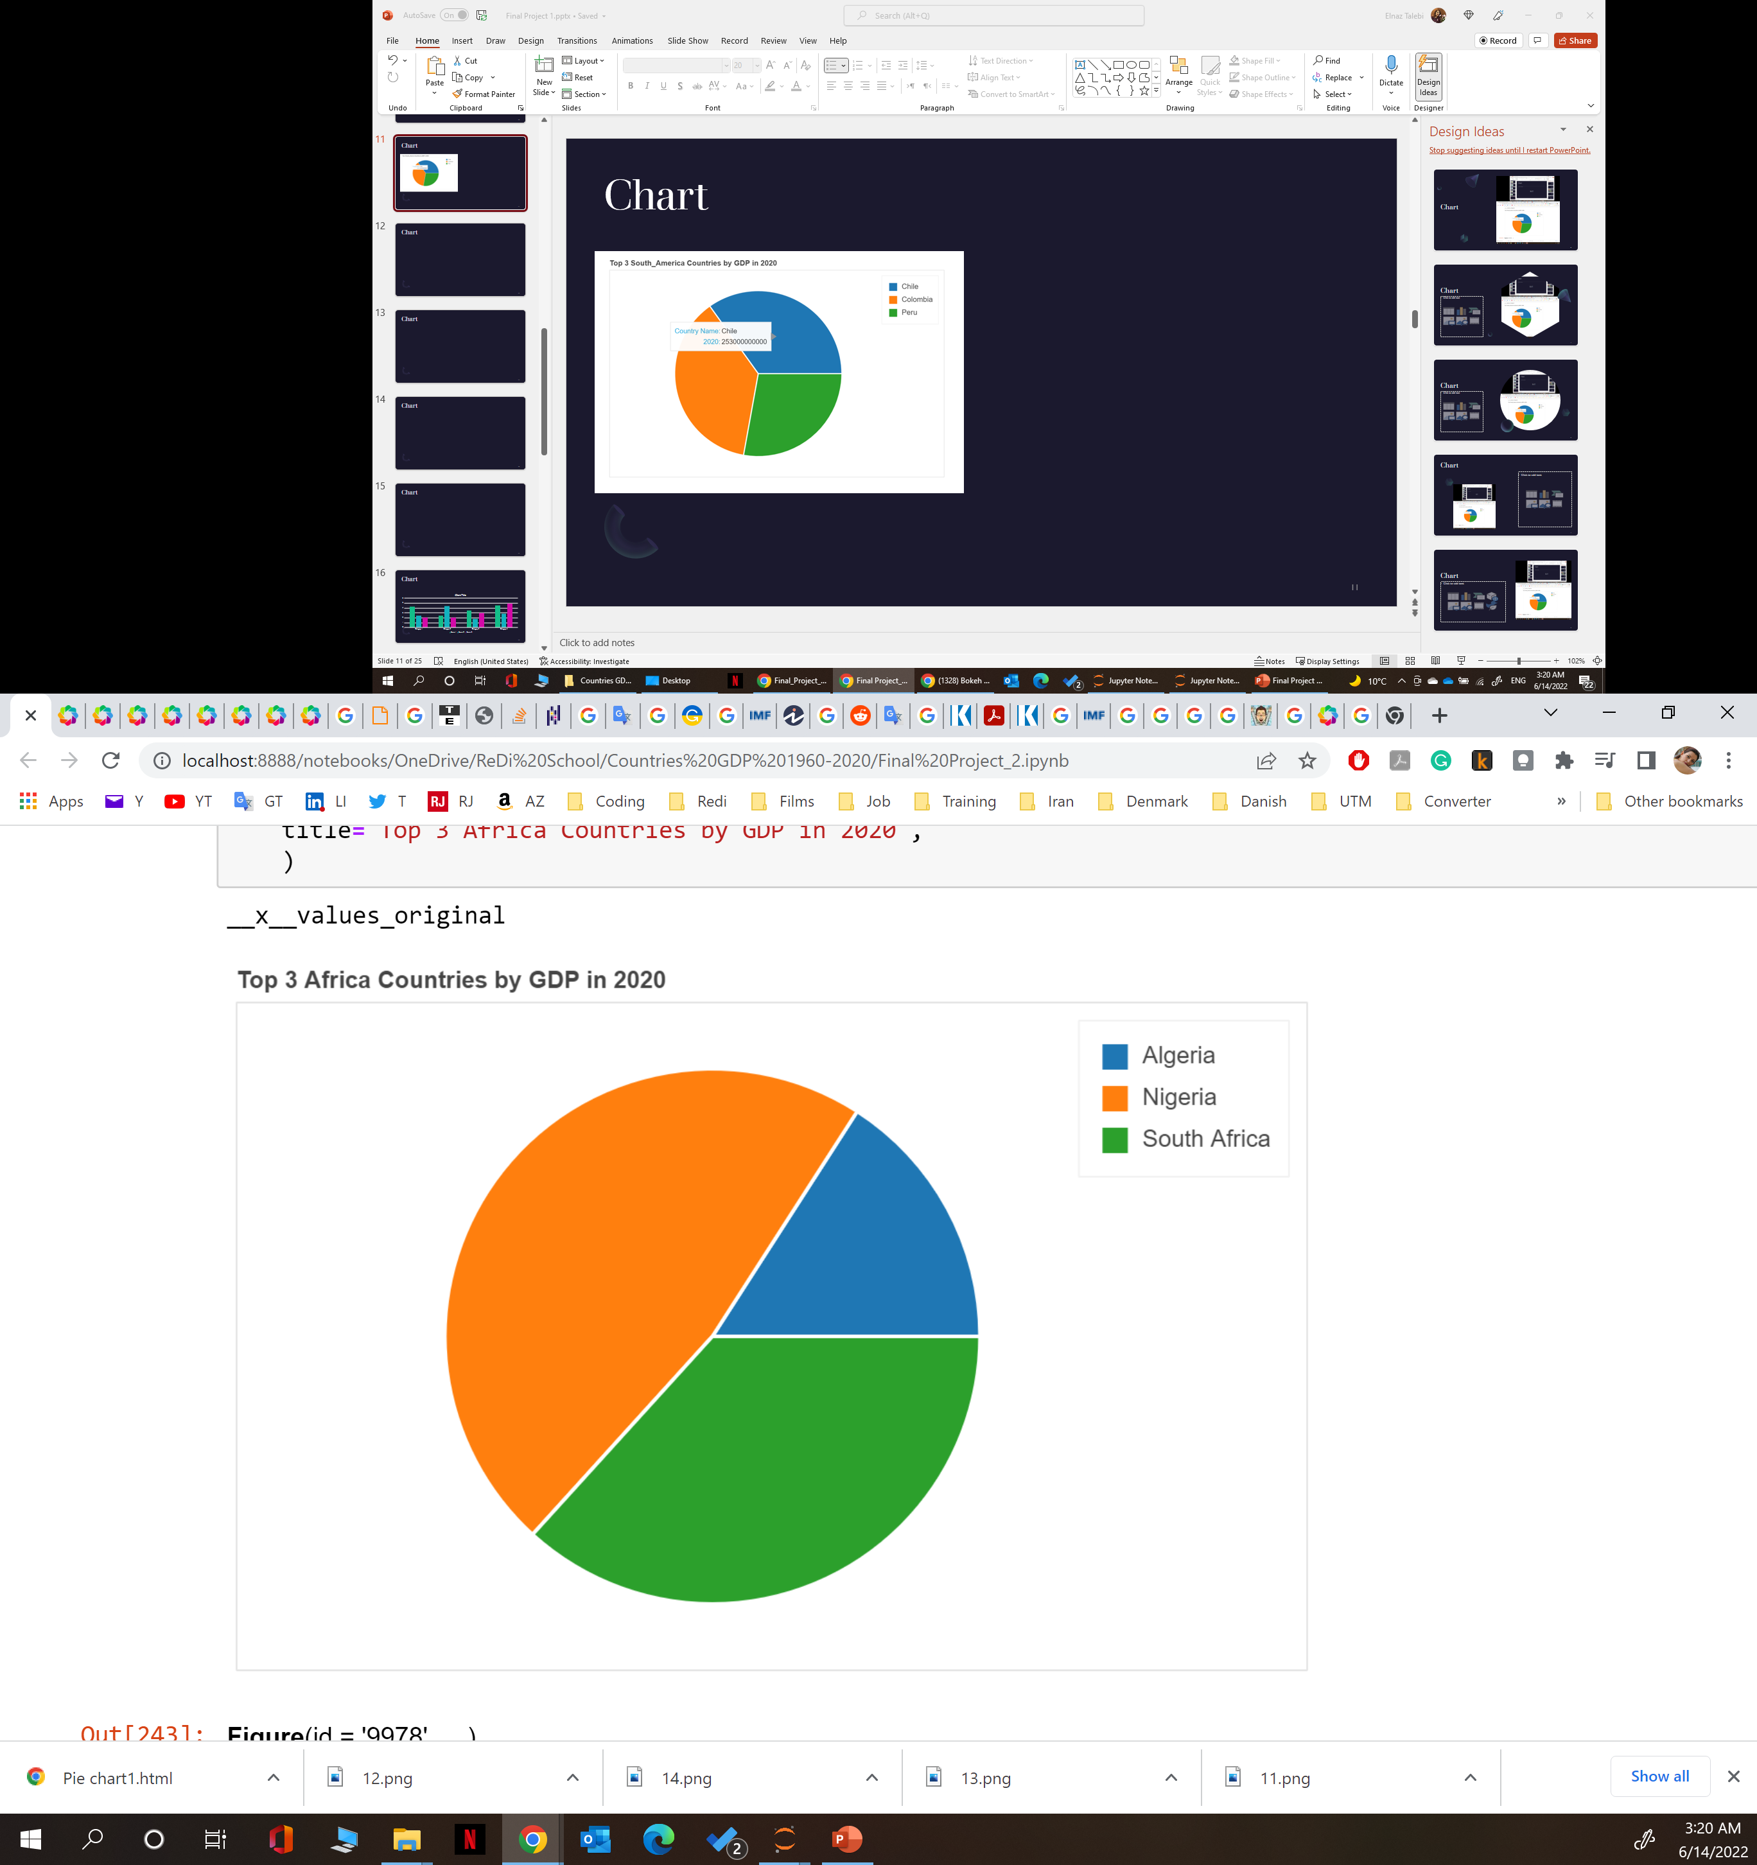
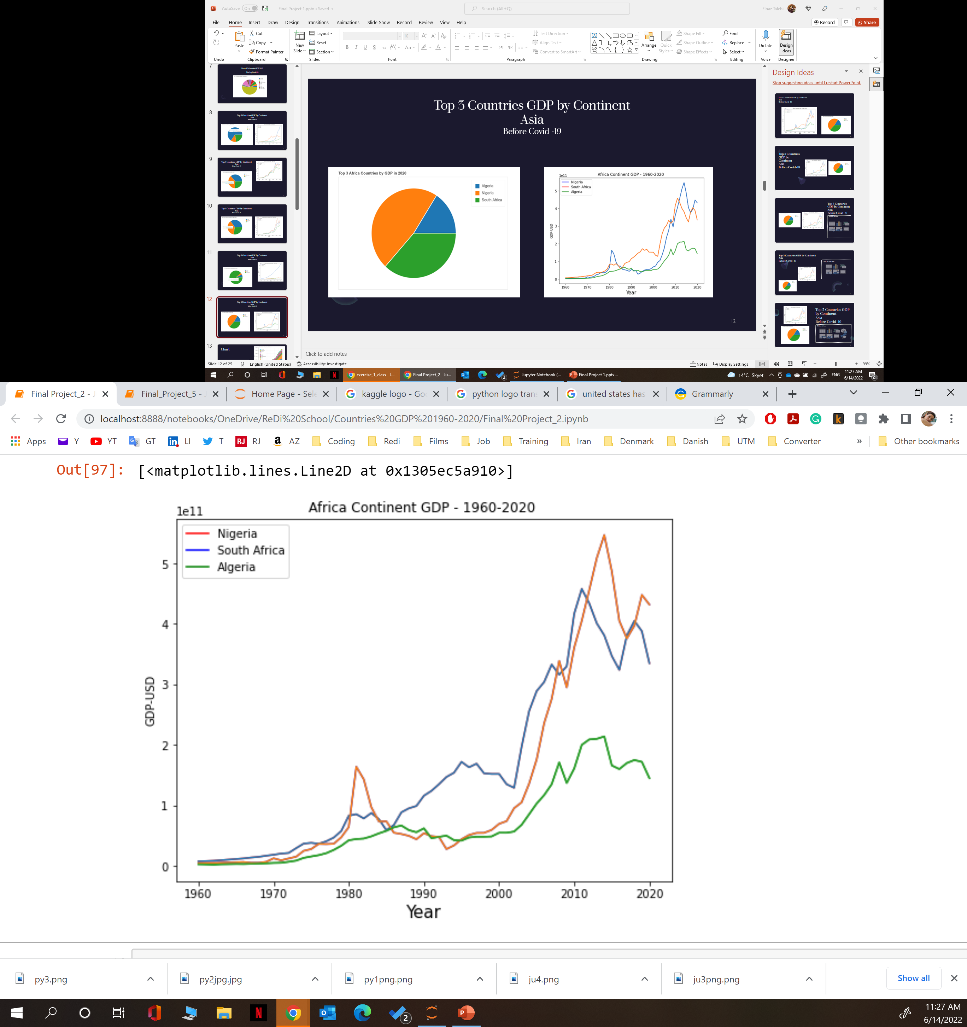
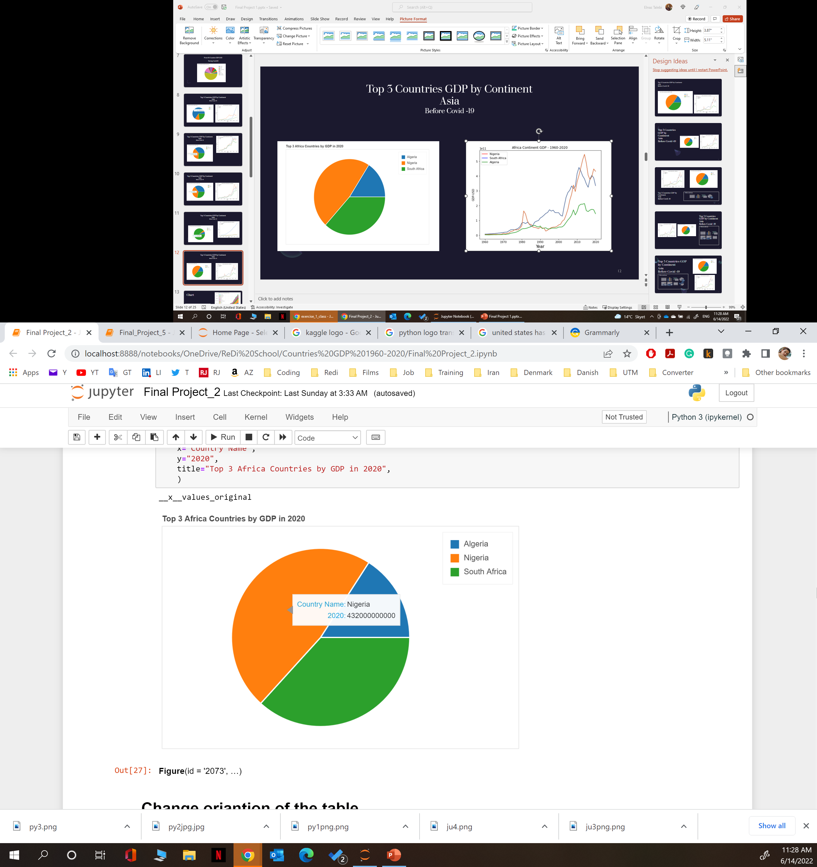
Top 3 Countries GDP by Continent Africa Before Covid -19

Slide 13
Visualize Countries GDP - World

Slide 14
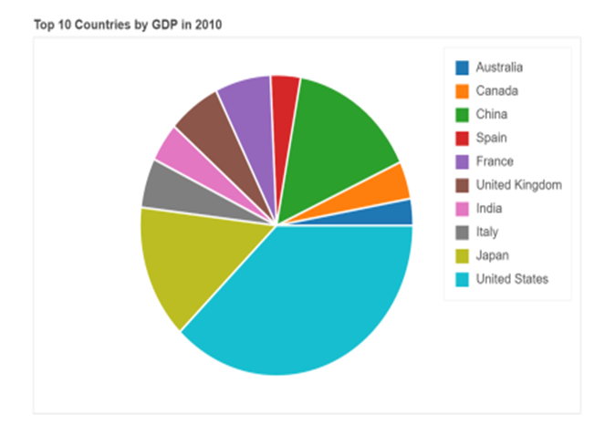
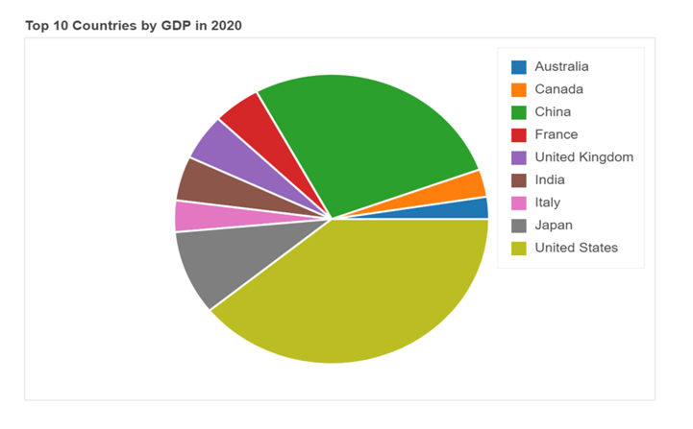
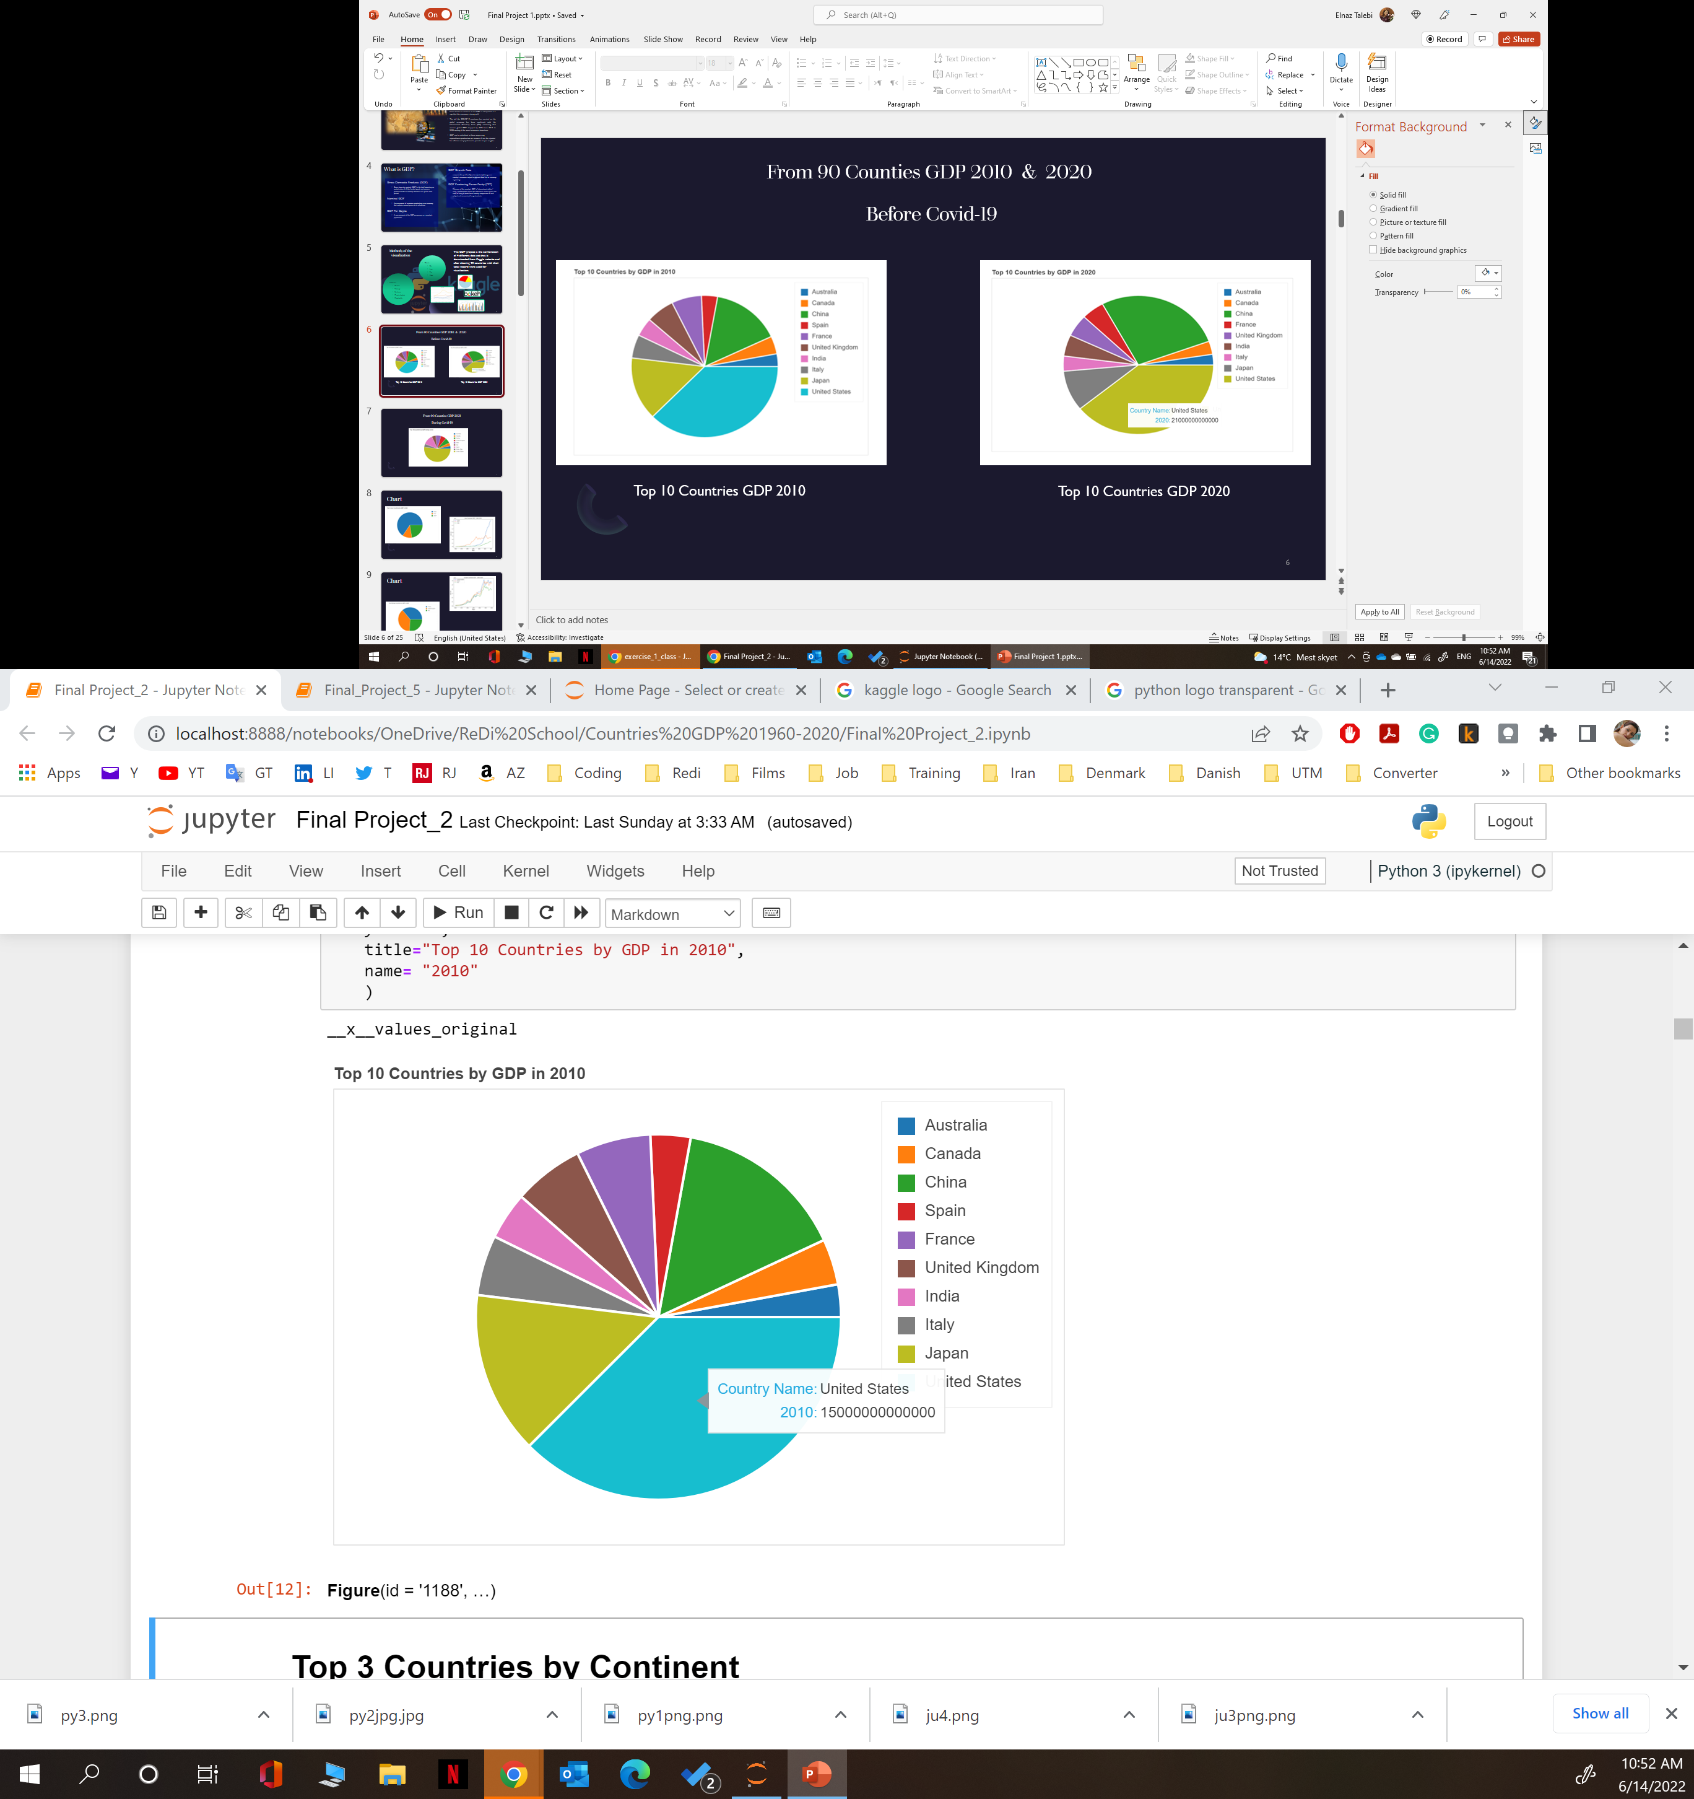
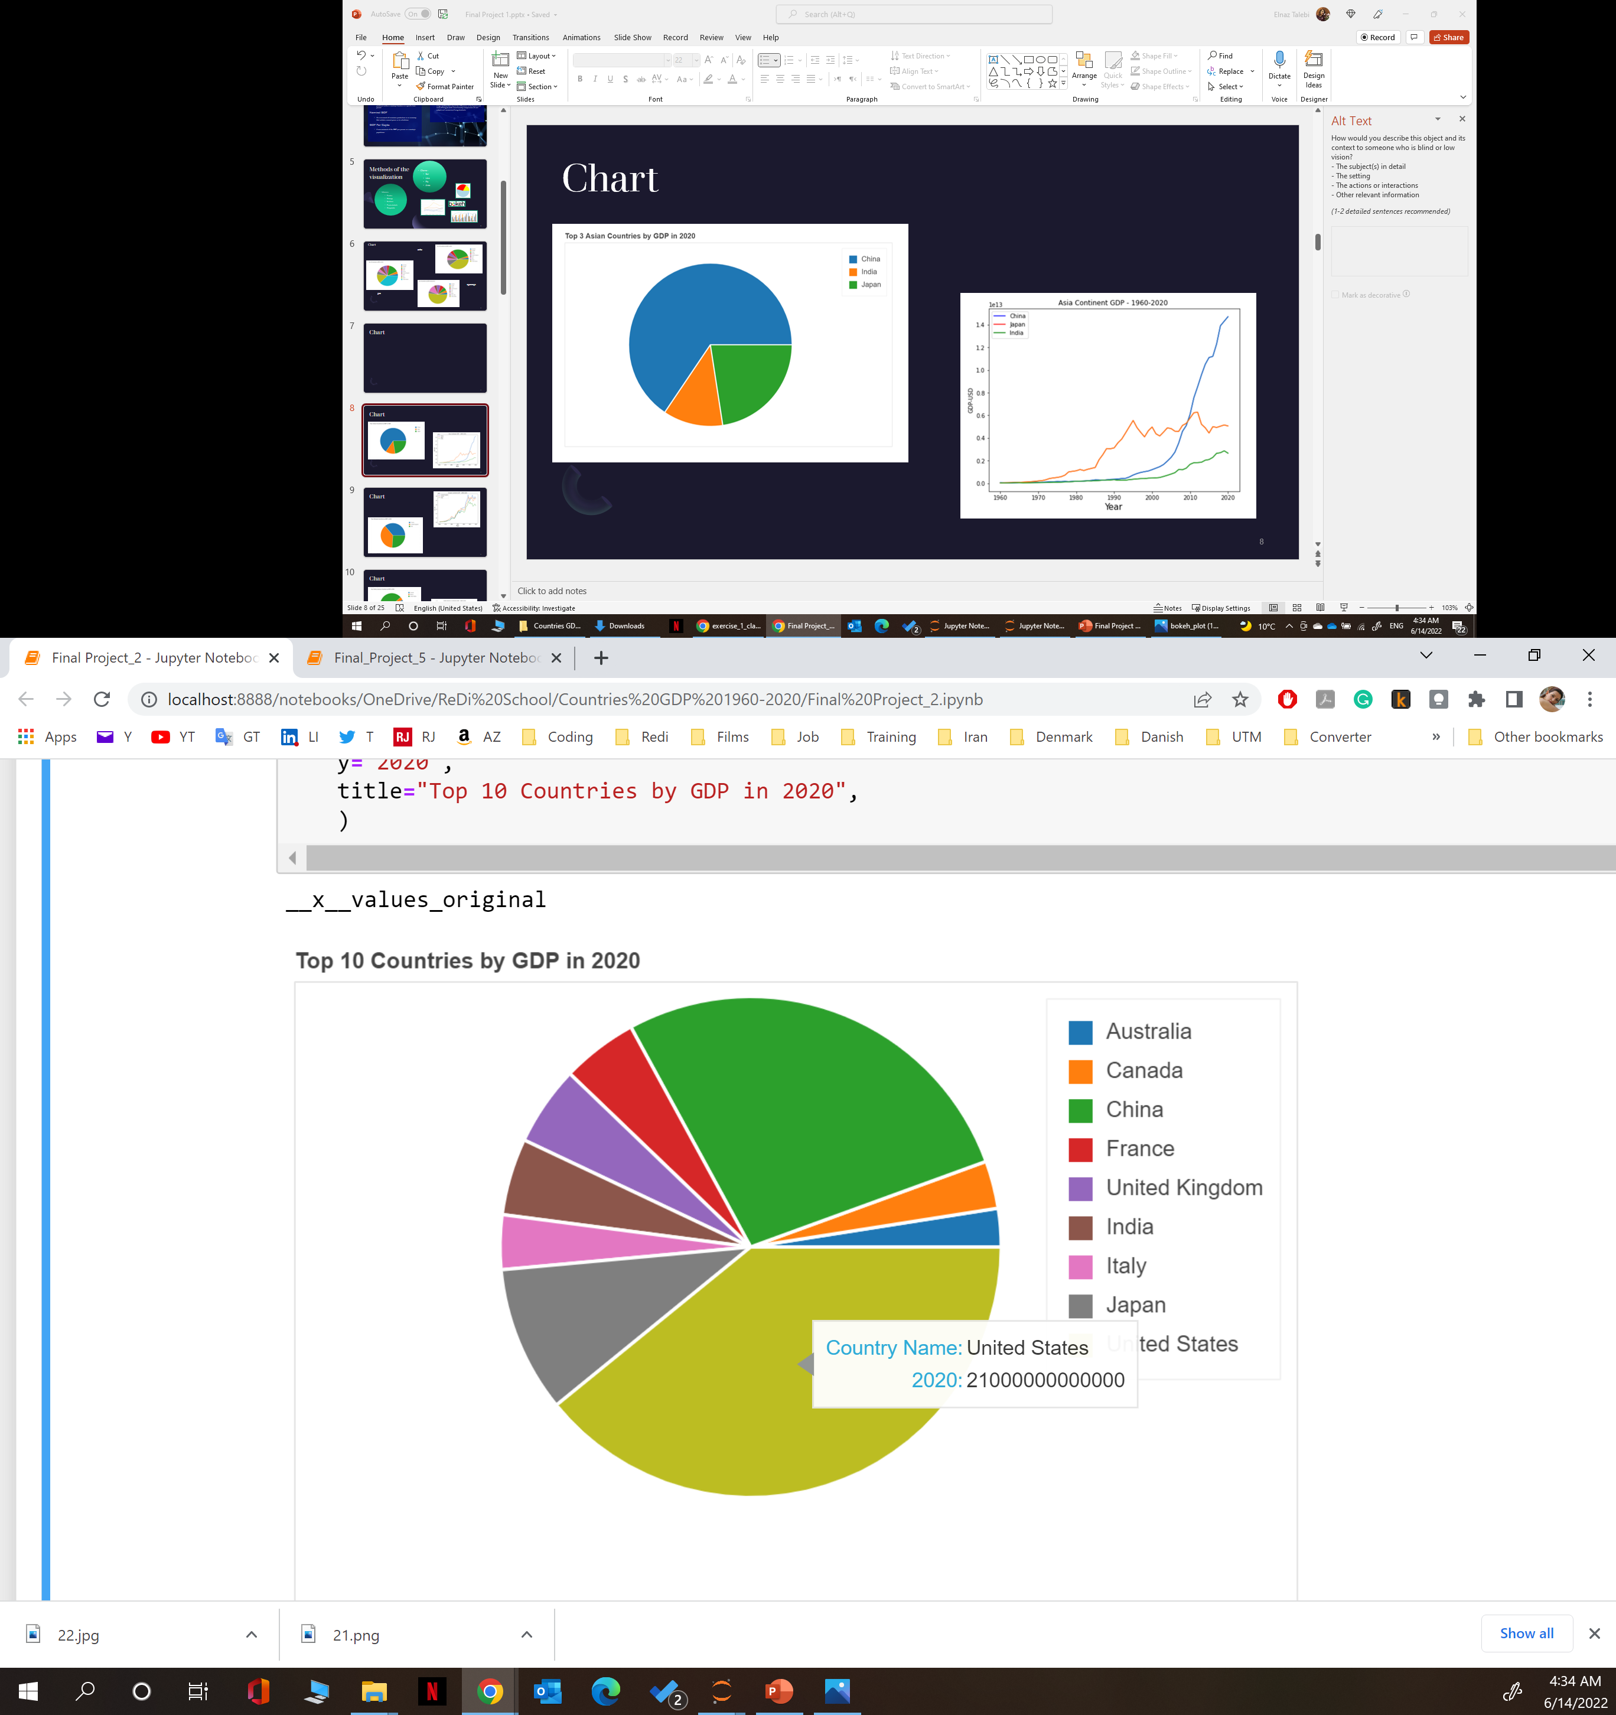
From 90 Countries GDP 2010 & 2020 Before Covid-19
Top 10 Countries GDP 2010
Top 10 Countries GDP 2020
Notes:
United States has the highest GDP

Slide 15
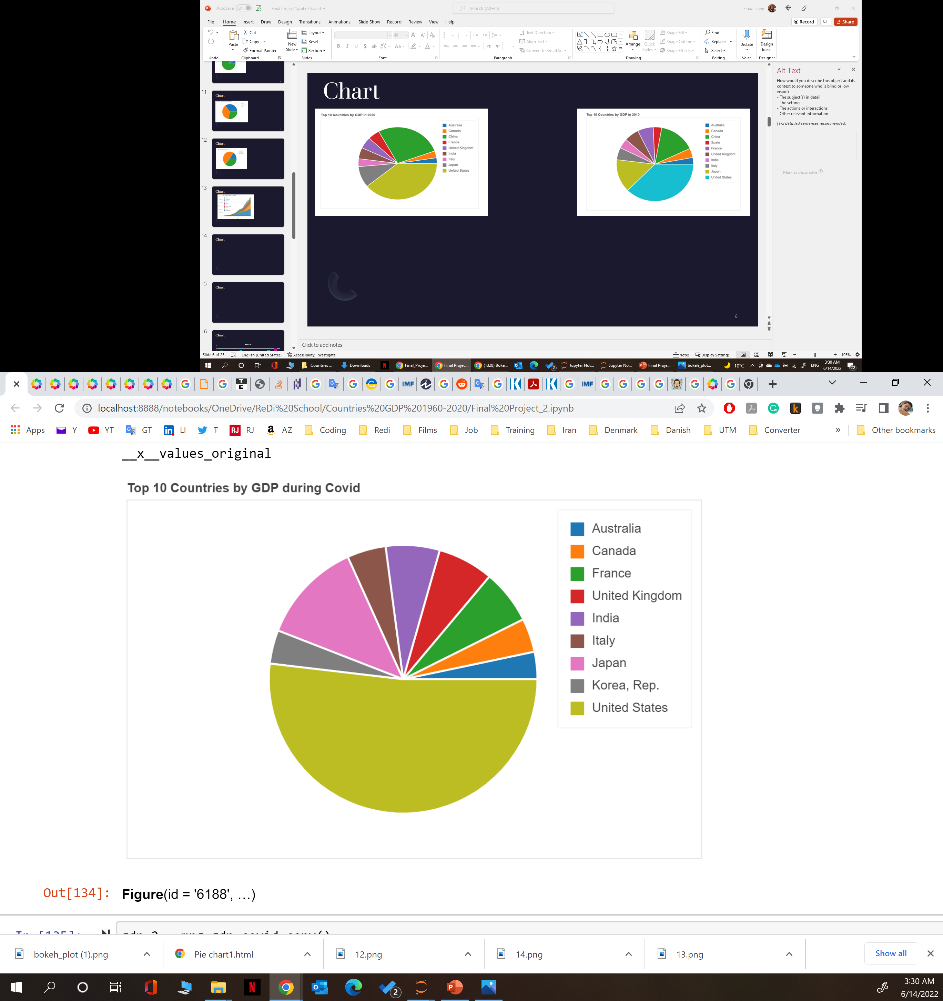
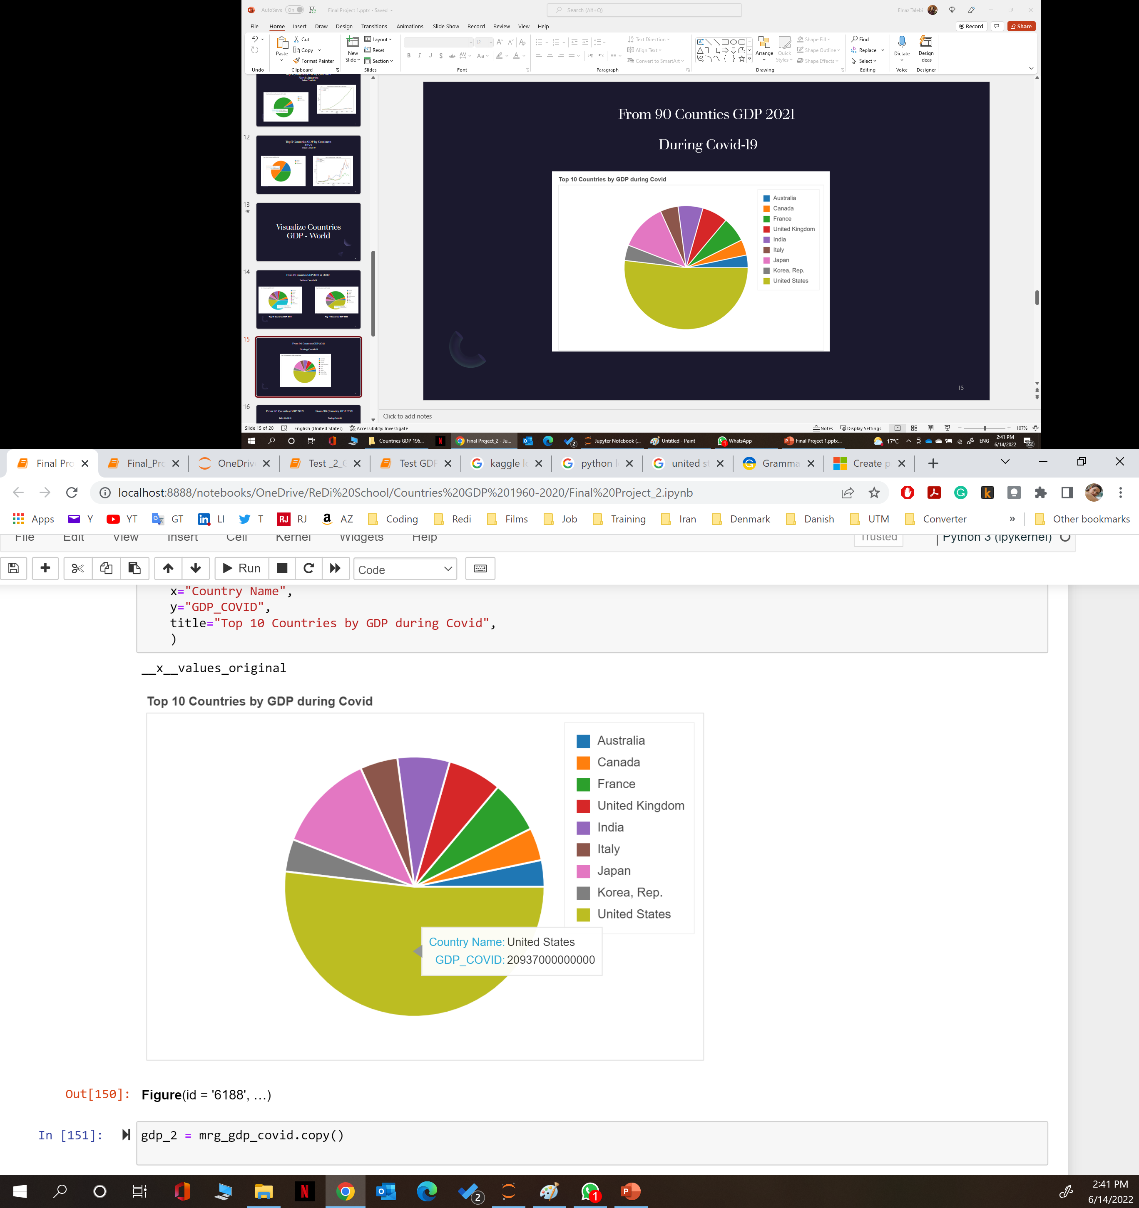
From 90 Countries GDP 2021 During Covid-19

Slide 16
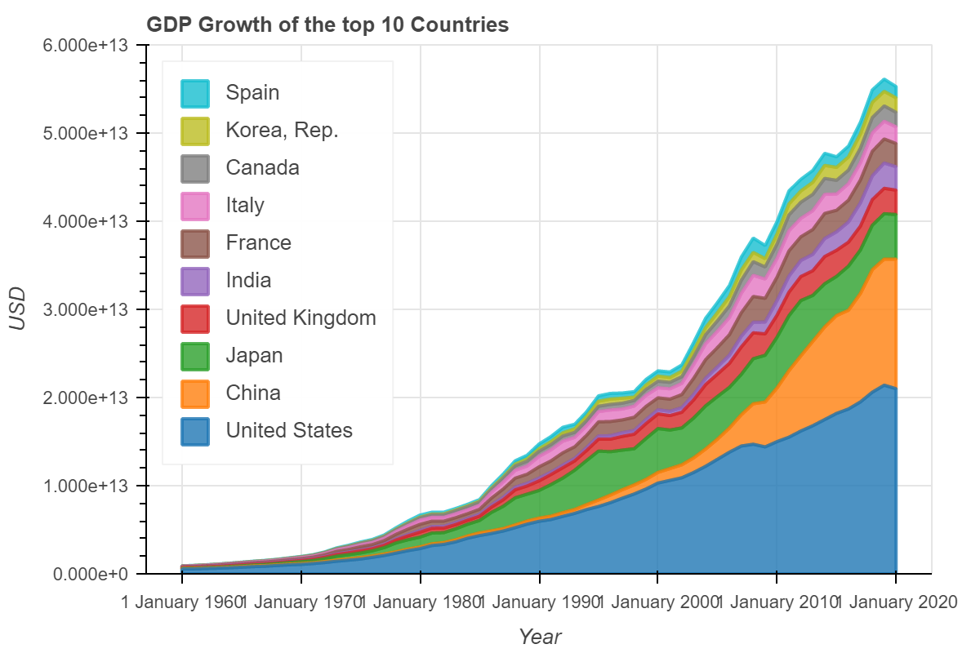
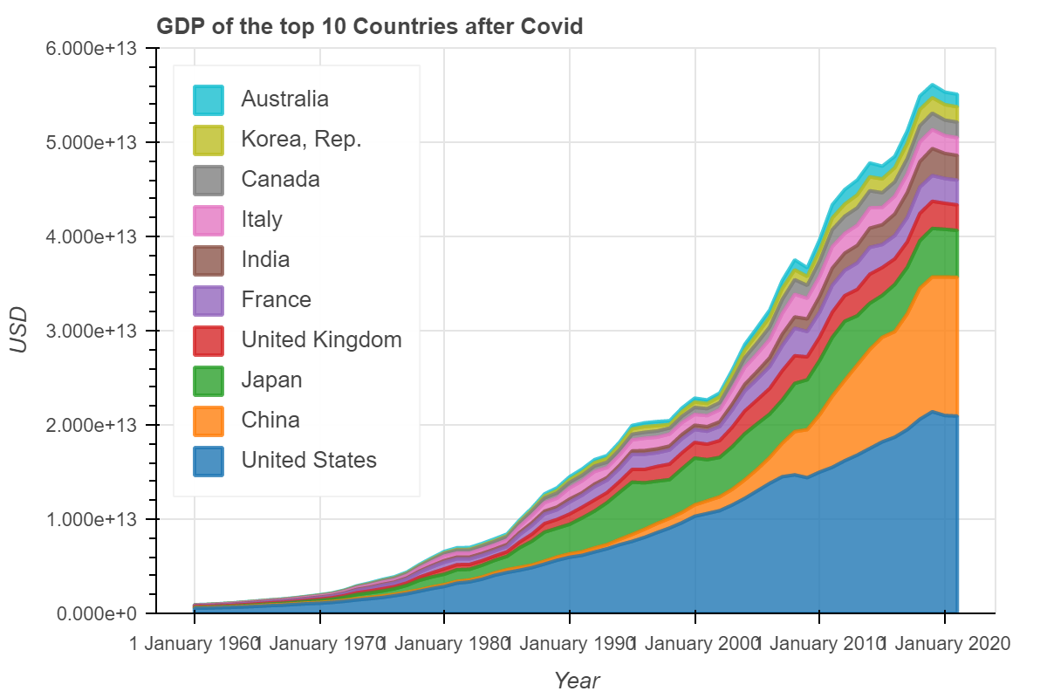
From 90 Countries GDP 2021 Befor Covid-19
From 90 Countries GDP 2021 During Covid-19
Notes:
As you can see here united states during 1960 to 2020 has the highest growth percentage

Slide 17
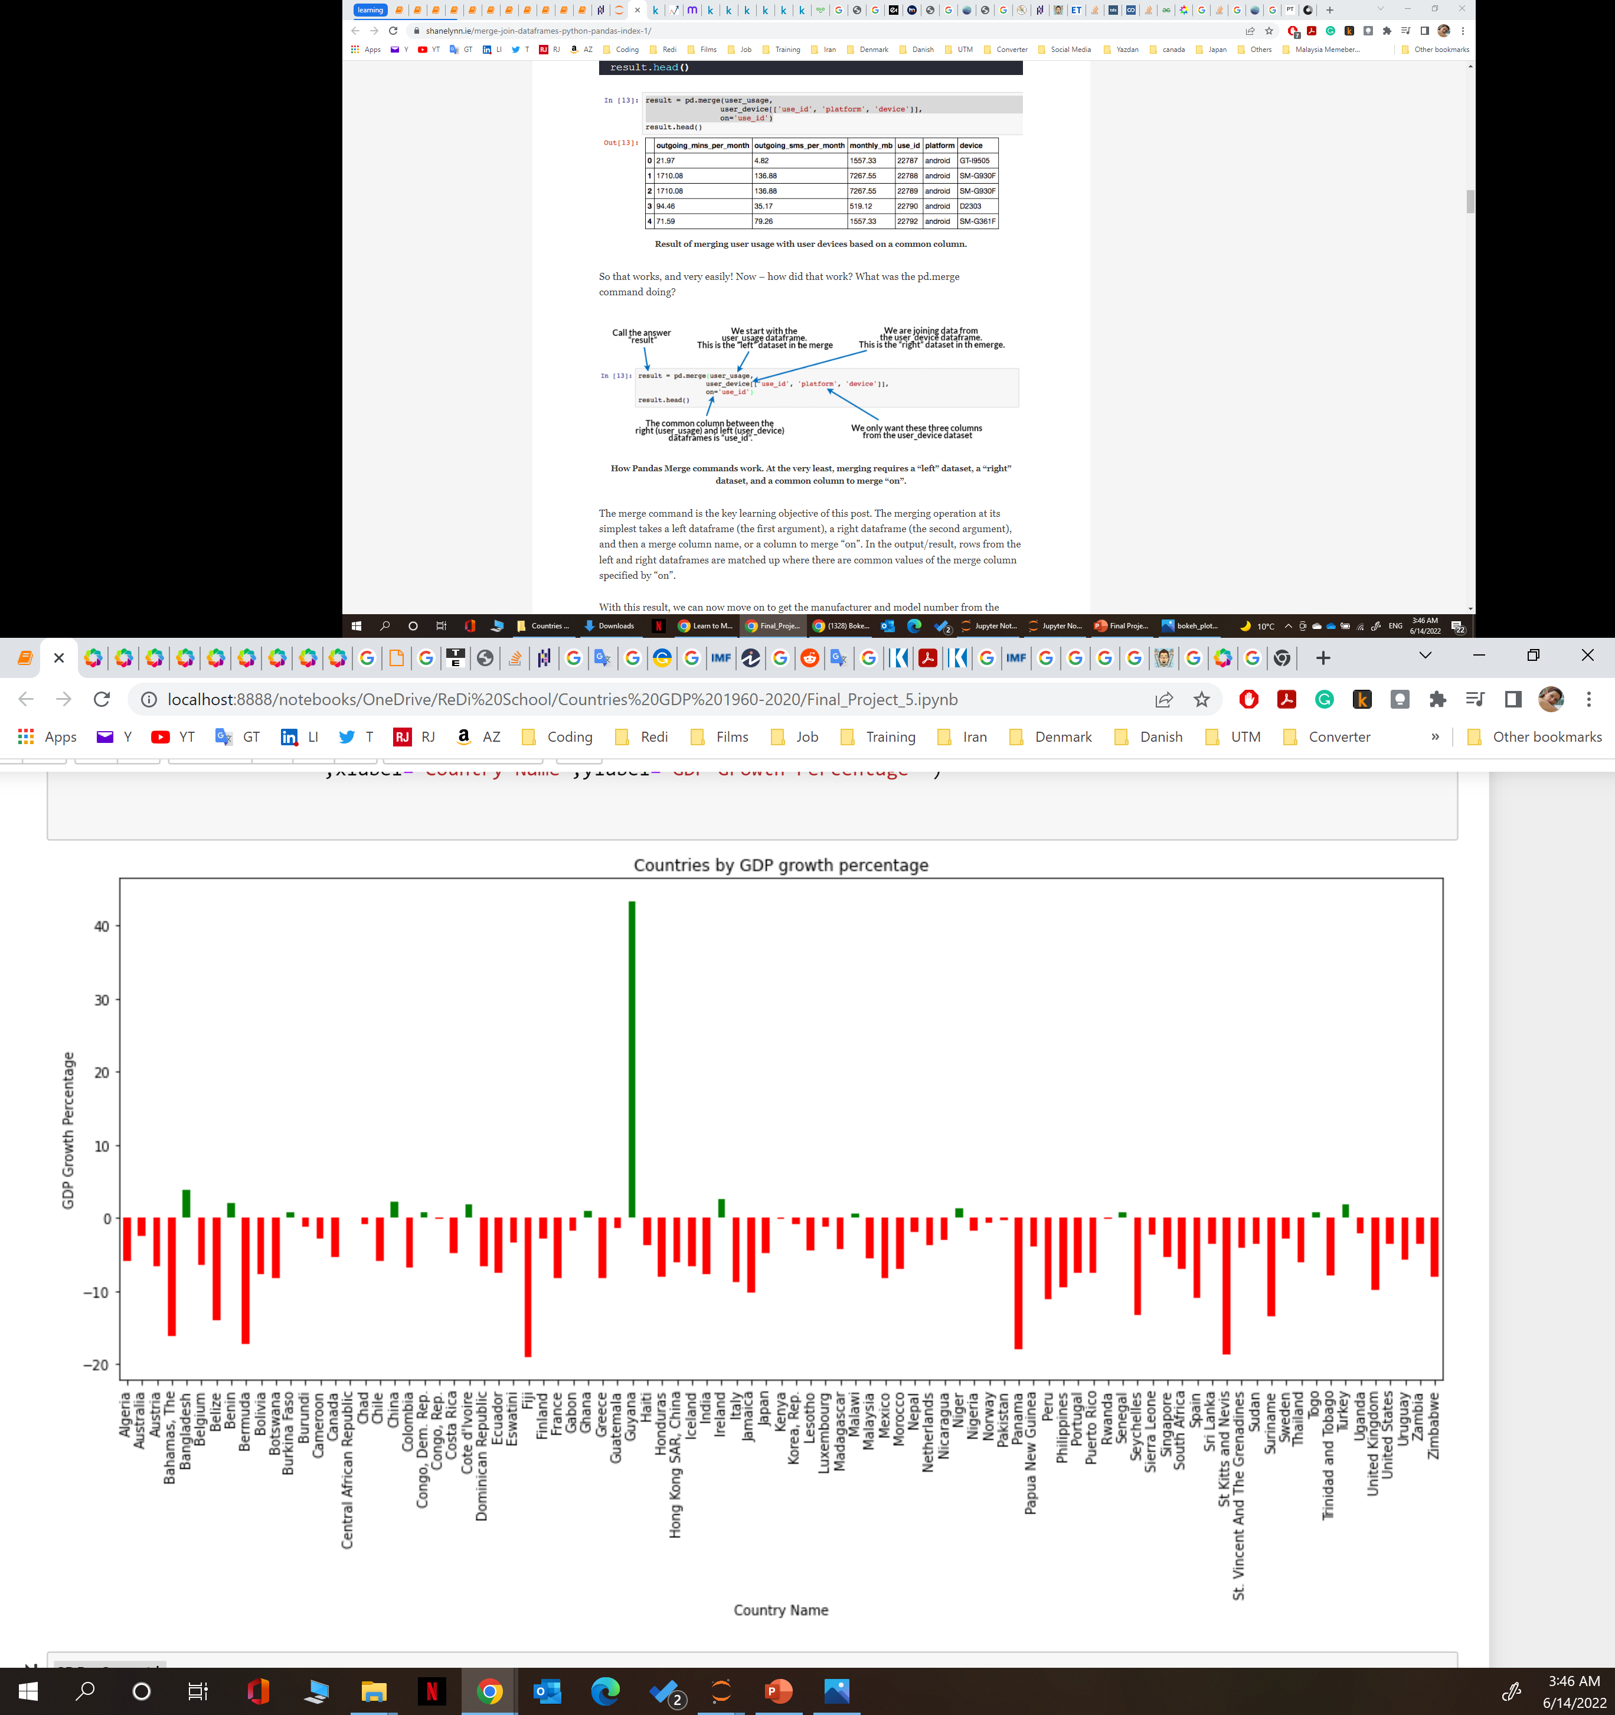
GDP Growth Percentage During Covid-19
Notes:
Guyana country with 43.3 percentage is a very high-rise GDP, and Fiji country with -19 percentage is the very high-fall GDP

Slide 18
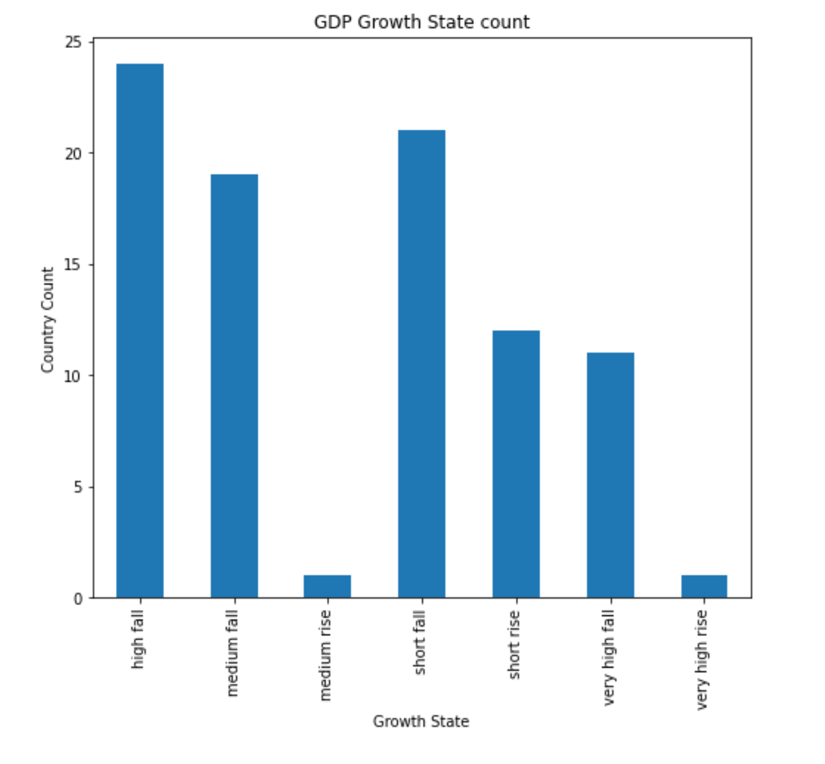
GDP Growth Statement During Covid-19
Notes:
Short Fall
Medium Fall
High Fall
Very High Fall
Short rise
Medium Rise
Very High Rise

Slide 19

Reference:
https://www.kff.org/global-health-policy/issue-brief/economic-impact-of-covid-19-on-pepfar-countries/
https://www.imf.org/external/pubs/ft/fandd/basics/gdp.htm#:~:text=GDP%20is%20important%20because%20it,the%20economy%20is%20doing%20well.
https://www.investopedia.com/terms/g/gdp.asp

Slide 20
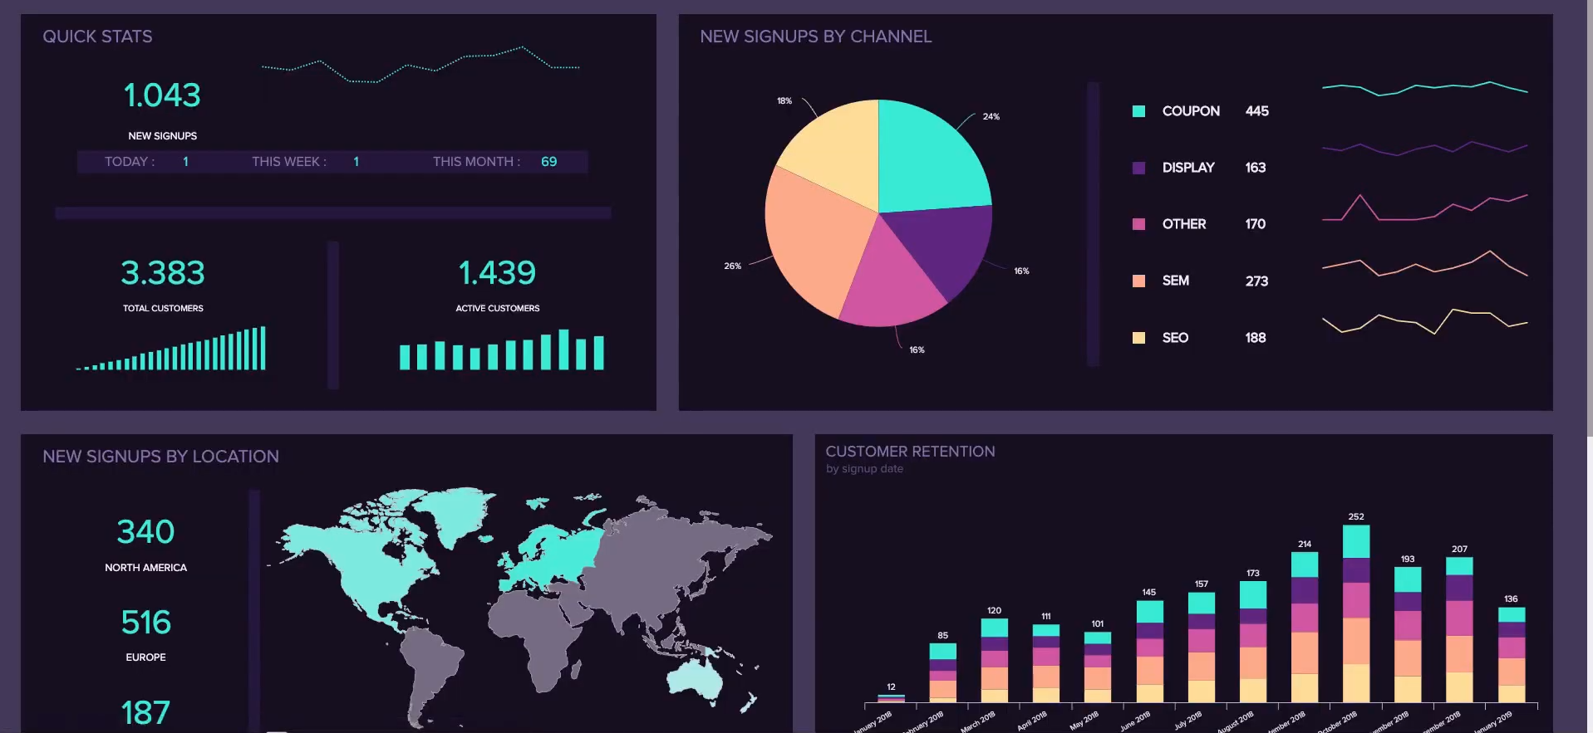

Thank You
Elnaz Talebi
Elnaz.talebi@hotmail.com
www.linkedin.com/in/elnaz-talebi

Slide 21



GDP fluctuation by Covid Pandemic
GDP Growth Percentage During Covid-19
GDP: Gross Domestic Products
The toll the COVID-19 pandemic has exacted on the global economy has been significant, with the International Monetary Fund (IMF) estimating that median global GDP dropped by 3.9% from 2019 to 2020, making it the worst economic downturn (kff.org).
Top 10 Countries GDP 2021 Befor Covid-19
Top 10 Countries GDP 2021 During Covid-19

